Slide 1
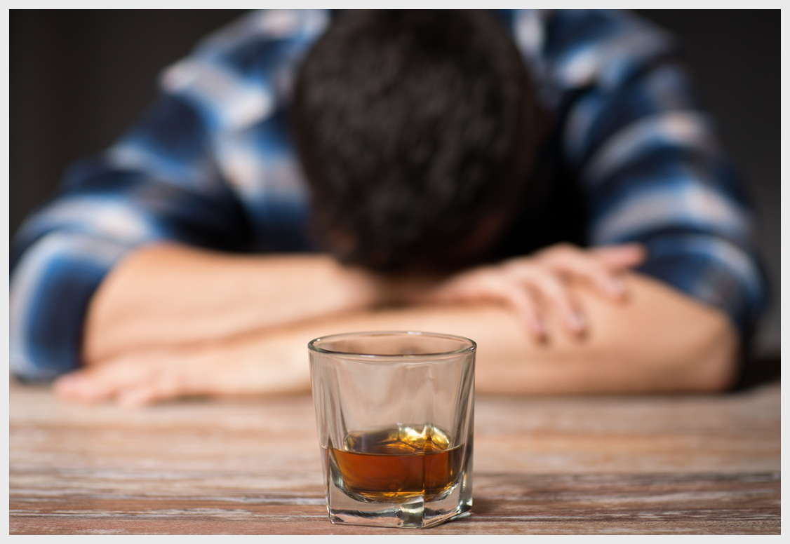
Drug Trends Training for Educators, Parents and Other Community Members
Presentation Created for
South Carolina Department of Alcohol & Other Drug Abuse Services

Slide 2
HOUSEKEEPING
This presentation is intended for educational purposes only for educators, schools, and parents (not intended for youth).
This is a drug awareness presentation. If you need more help/resources, please contact your local prevention/education agencies.
Everything is person-specific. "No one thing means any one thing."
Images are purchased stock images.
Created July 2020

Slide 3
Topics Highlighted in This Presentation
Underage drinking of alcohol
Teen marijuana trends
New forms of marijuana
Youth prescription pill use
Youth vaping trends and dangers
Marijuana edibles
State-specific information
Tips to keep your kids drug free
Sources for parents and professionals

Slide 4
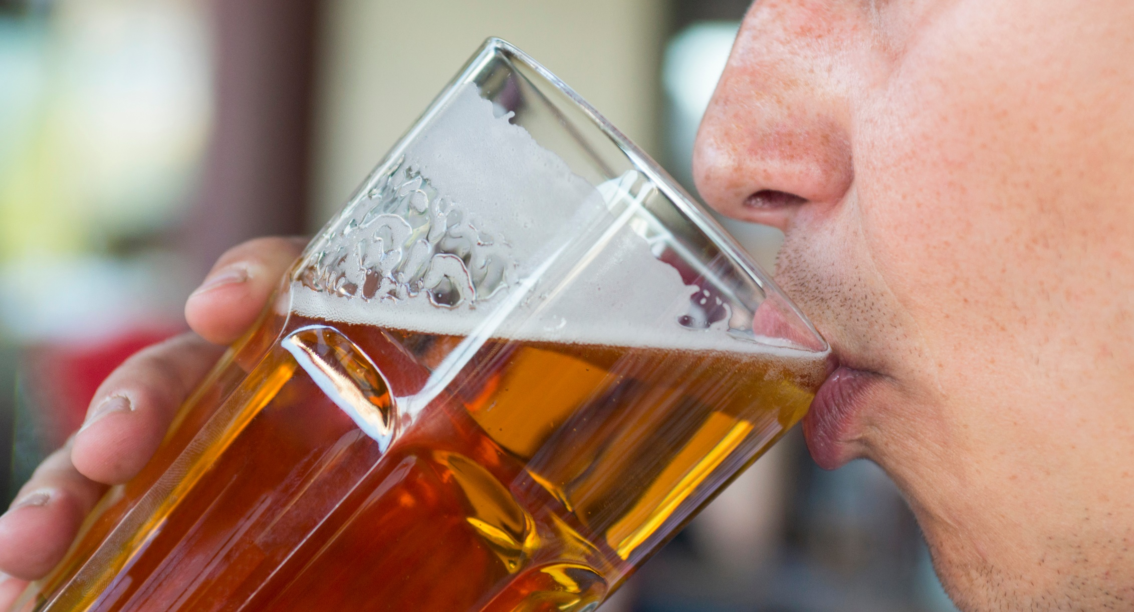
YOUTH ALCOHOL USE

Slide 5
Alcohol Facts and Tips
21 years of age is the minimum legal drinking age in all 50 states.
Binge drinking is the most common, costly, and deadly pattern of excessive alcohol use in the United States. Binge drinking is defined as a pattern of drinking that brings a person’s blood alcohol concentration (BAC) to 0.08 g/dl or above. This typically happens when men consume 5 or more drinks or women consume 4 or more drinks in about 2 hours. Most people who binge drink are not alcohol dependent.
Most people younger than 21 who drink alcohol report binge drinking, often consuming large amounts.
Source: cdc.gov

Slide 6
Underage Drinking
Consequences of Underage Drinking
Youth who drink alcohol are more likely to experience:
School problems, such as higher number of absences and poor or failing grades
Social problems, such as fighting and lack of participation in youth activities
Legal problems, such as arrest for driving or physically hurting someone while drunk
Physical problems, such as hangovers or illnesses
Unwanted, unplanned, and unprotected sexual activity
Source: https://www.cdc.gov/alcohol/fact-sheets/underage-drinking.htm

Slide 7
Consequences of Underage Drinking (continued)
Disruption of normal growth and sexual development
Physical and sexual assault
Higher risk for suicide and homicide
Alcohol-related car crashes and other unintentional injuries, such as burns, falls, and drowning
Memory problems
Misuse of other drugs
Changes in brain development that may have lifelong effects
Death from alcohol poisoning

Slide 8
Alcohol Tips for Adults
Be a good example. Our youth are always paying attention to how (adults) consume alcohol and the example we set.
Find out what they know…Ask questions.
Educate yourself on alcohol (and other drug) trends in your community and state. This will help you to talk with your youth about alcohol abuse.
Have frequent "quick" conversations whenever the opportunity arises. A great place is at the dinner table.
STAY INVOLVED !!!!

Slide 9
Parents – What Can You Do?
If you choose to drink, model responsible drinking behavior. A child with a parent who binge drinks is much more likely to binge drink than a child whose parents do not. Try to avoid sending any unintended messages — find ways to celebrate and relax without alcohol.
Don’t make alcohol available to your child or their friends. This isn’t only a matter of safety. Depending on where you live, it could be the law.
Kids ages 11-14 see approximately 1,000 alcohol ads a year. Discuss what you see and help put context around the alcohol messaging your child receives from friends and the media.
Supervise any parties in your home to make sure there is no alcohol — and make sure your teens know the rules ahead of time. Learn more about social hosting laws and what they can mean for your personal liability in the event of underage drinking in the home.
Source: Drug free.org:
https://drugfree.org/article/how-to-address-underage-drinking/

Slide 10
Parents – What Can You Do?
(continued)
Is your child socializing at someone else’s home? Know where he or she will be. Call the parents in advance to verify the occasion and location and that there will be supervision. If the activity seems inappropriate, express concern and keep your child home.
Communicate your expectations and rules for when your teen goes out with friends, and include regular check-ins.
Assure your child that he or she can call you to be picked up whenever needed.
Create a contract establishing rules about drugs and alcohol.
Source: https://drugfree.org/article/how-to-address-underage-drinking/

Slide 11
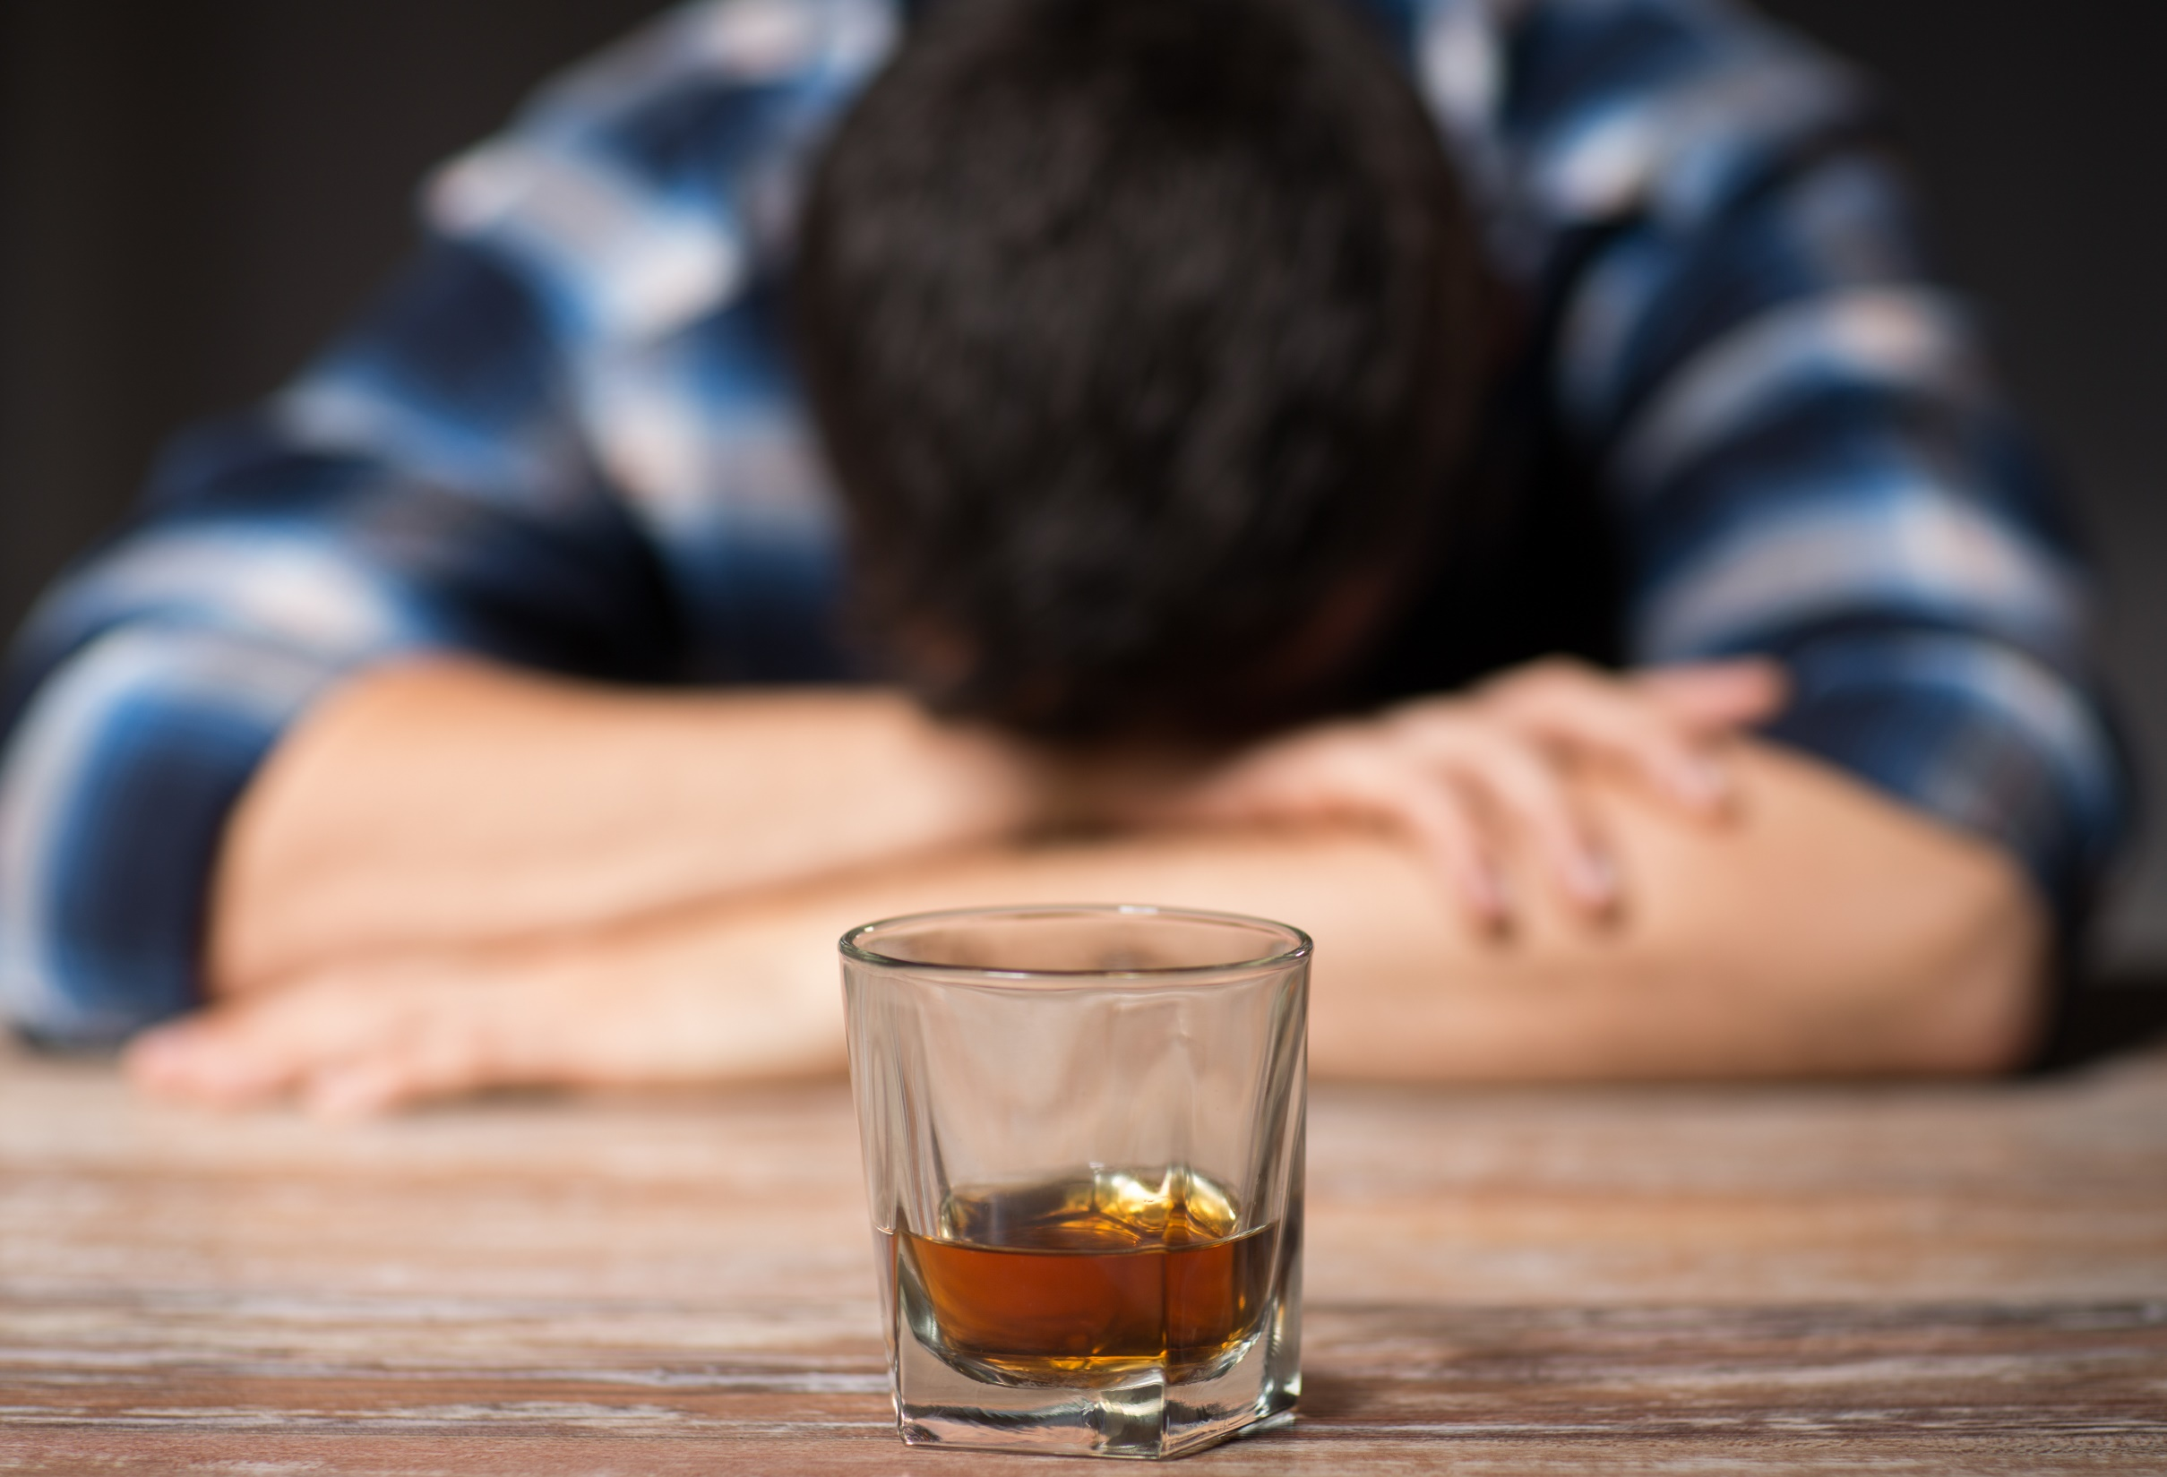
BINGE DRINKING

Slide 12
Binge Drinking
Binge drinking is the most common, costly, and deadly pattern of excessive alcohol use in the United States.
Binge drinking is defined as a pattern of drinking that brings a person’s blood alcohol concentration (BAC) to 0.08 g/dl or above. This typically happens when men consume 5 or more drinks or women consume 4 or more drinks in about 2 hours. Most people who binge drink are not alcohol dependent.

Slide 13
The Role of Parents & Prevention
Parents and teachers can play a big role in shaping young people’s attitudes toward drinking. Parents in particular can have either a positive or negative influence.
Parents can help their children avoid alcohol problems by:
Talking about the dangers of drinking
Drinking responsibly, if they choose to drink
Serving as positive role models in general
Not making alcohol available
Getting to know their children’s friends
Having regular conversations about life in general
Connecting with other parents about sending clear messages about the importance of not drinking alcohol
Supervising all parties to make sure there is no alcohol
Encouraging kids to participate in healthy and fun activities that do not involve alcohol
Source: https://www.niaaa.nih.gov/publications/brochures-and-fact-sheets/underage-drinking

Slide 14
The Role of Parents & Prevention
(continued)
Research shows that children whose parents are actively involved in their lives are less likely to drink alcohol.
On the other hand, research shows that a child with a parent who binge drinks is much more likely to binge drink than a child whose parents do not binge drink
Source: https://www.niaaa.nih.gov/publications/brochures-and-fact-sheets/underage-drinking

Slide 15
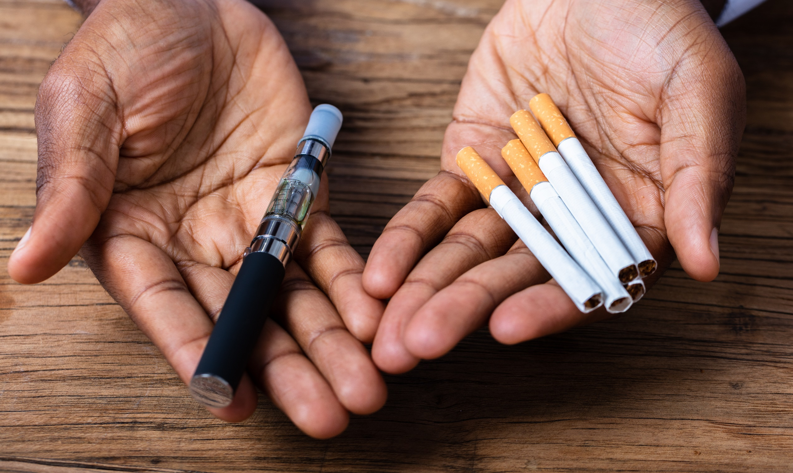
VAPING

Slide 16
What Is a Vape Pen ?
Vapes, vaporizers, vape pens, hookah pens, electronic cigarettes (e-cigarettes or e-cigs), and e-pipes are some of the many terms used to describe electronic nicotine delivery systems (ENDS).
ENDS are noncombustible tobacco products.
These products use an "e-liquid" that may contain nicotine, as well as varying compositions of flavorings, propylene glycol, vegetable glycerin, and other ingredients. The liquid is heated to create an aerosol that the user inhales.
Source: fda.Gov

Slide 17
Vapor Aerosol Questions
What many of us call a "vapor" the CDC and other professionals reference as an aerosol. This is what is inhaled by the user when they take a draw on the vape similar to how they would take a draw from a regular tobacco cigarette.
In other words, the "vapor" is actually an "aerosol."

Slide 18
What Is E-cigarette Aerosol?
The e-cigarette aerosol that users breathe from the device and exhale can contain harmful and potentially harmful substances, including:
Nicotine
Ultrafine particles that can be inhaled deep into the lungs
Flavoring such as diacetyl, a chemical linked to a serious lung disease
Volatile organic compounds
Cancer-causing chemicals
Heavy metals such as nickel, tin, and lead
It is difficult for consumers to know what e-cigarette products contain. For example, some e-cigarettes marketed as containing 0% nicotine have been found to contain nicotine.
Source: cdc.gov

Slide 19
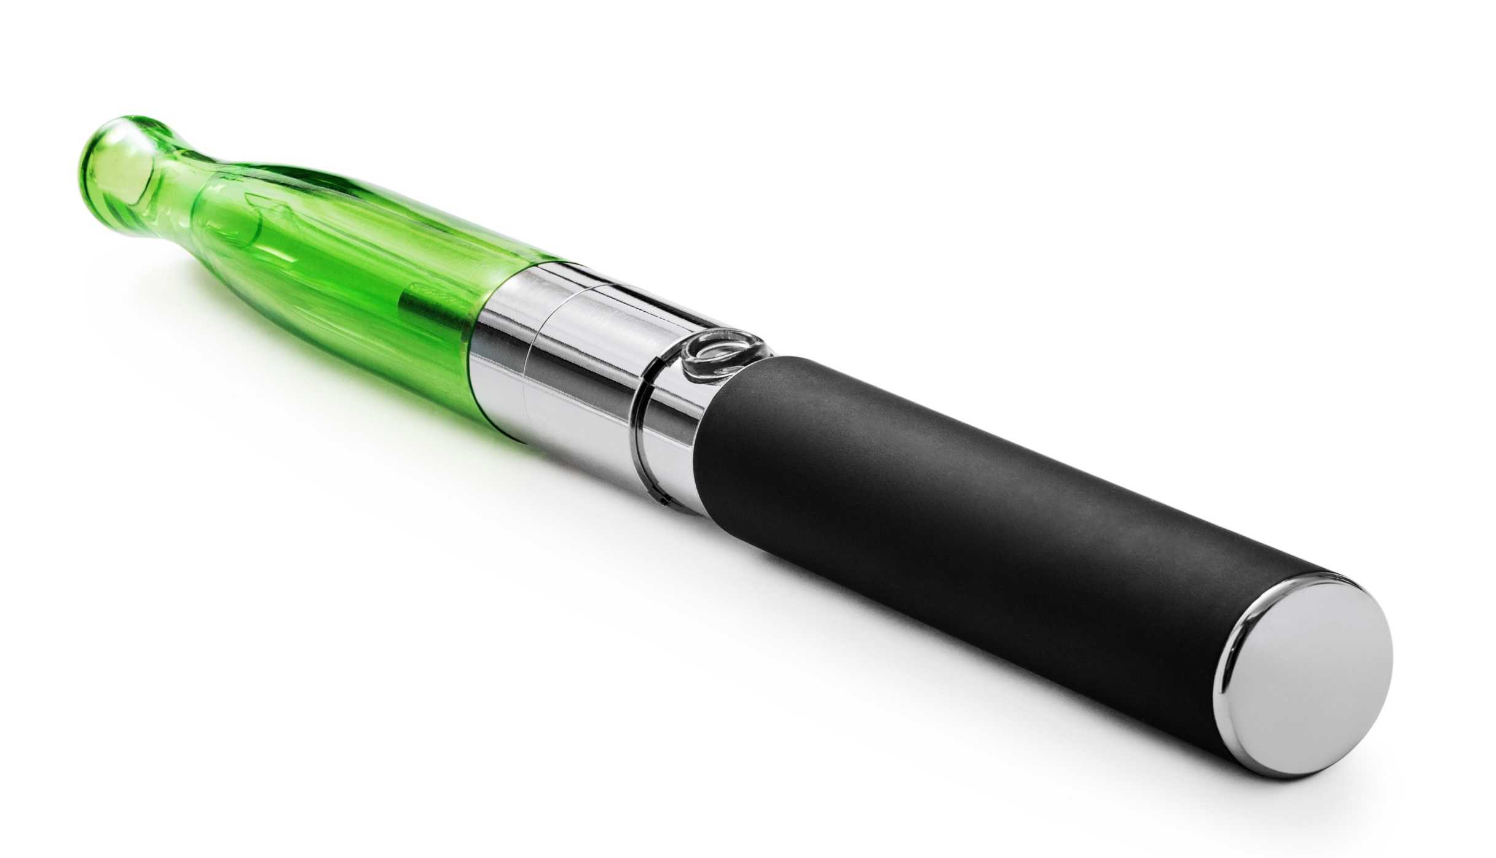
Vape Pen (AKA E-Cigarette)

Slide 20
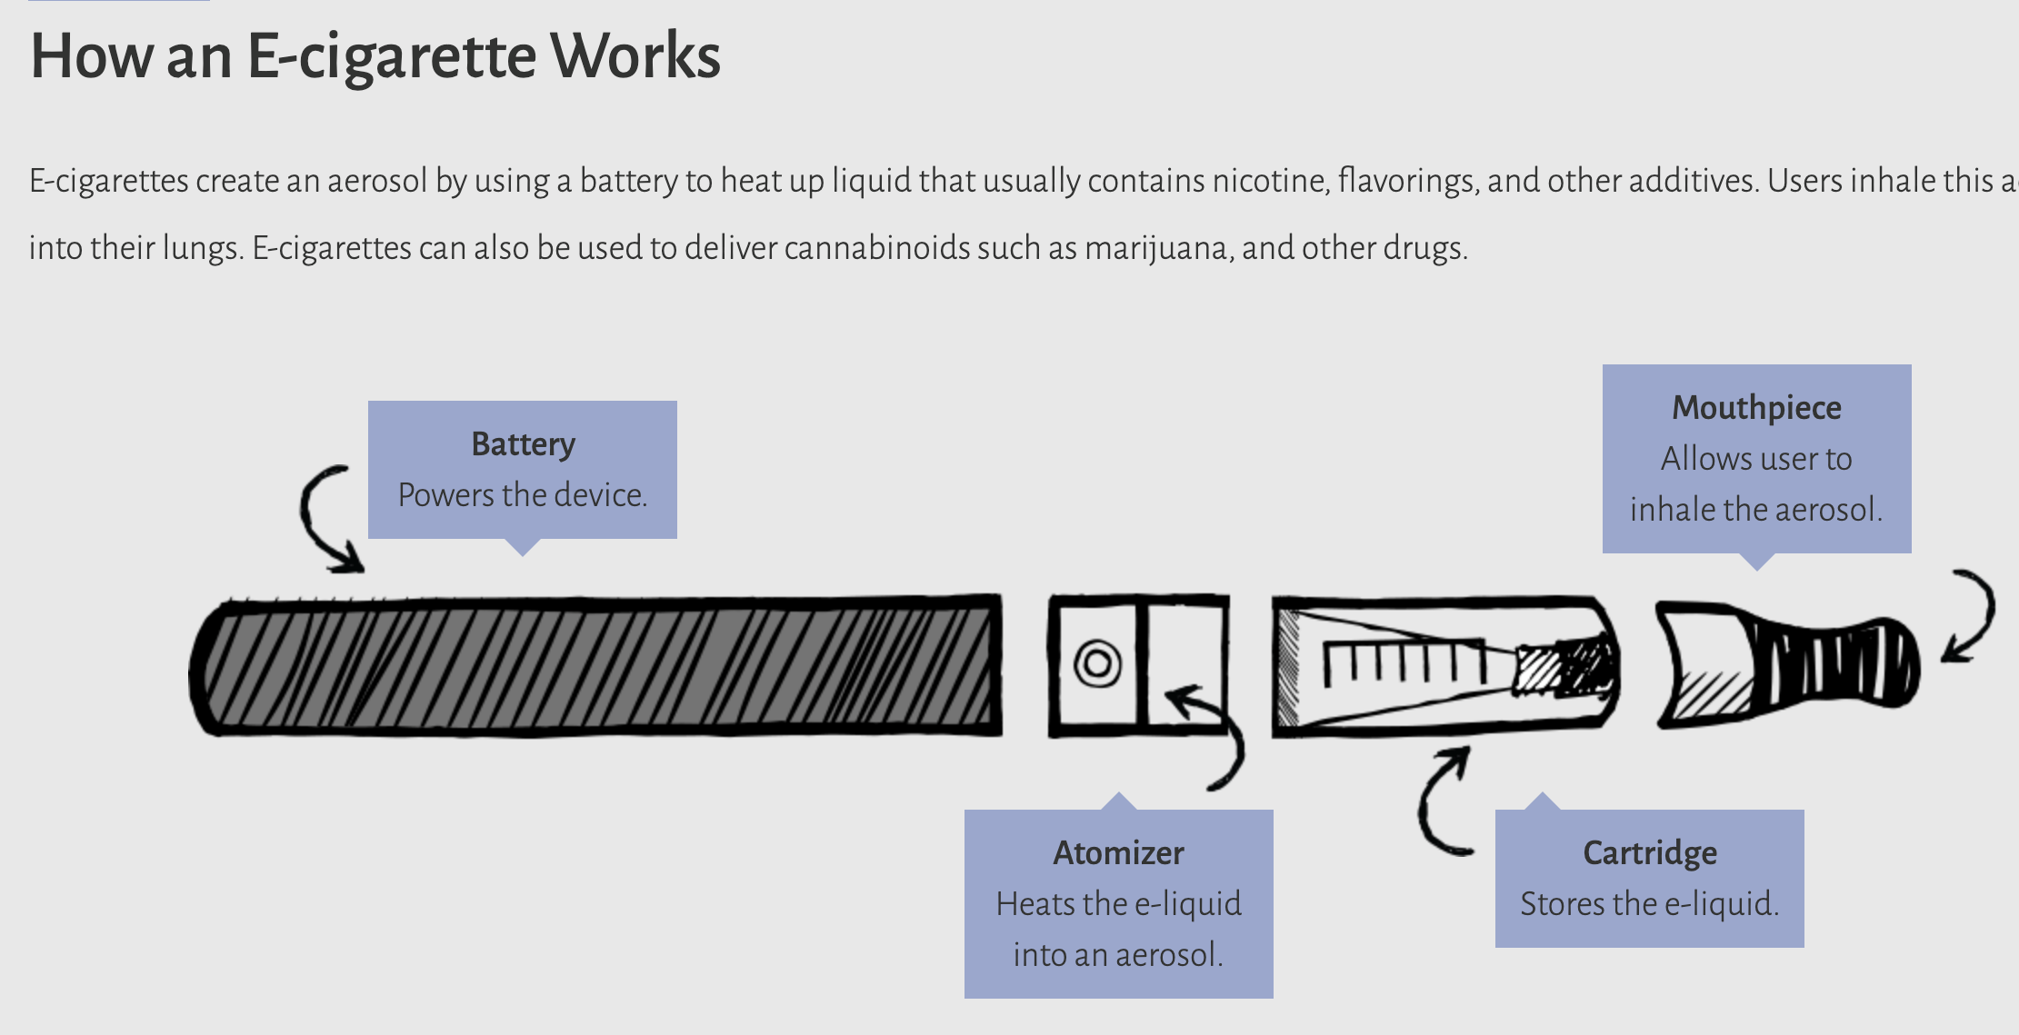
More info: https://e-cigarettes.surgeongeneral.gov/getthefacts.html
Source: surgeongeneral.gov

Slide 21
"Street-Level" Terms for Vape Pens
E-cigarette (E-cig) or Electronic Cigarette – the device we know as a "vape pen"
Dab Pen - a device used for the consumption of marijuana concentrates. Dab pens can look like standard nicotine vape pens.
MOD(s) – a larger, bulkier, (modified) device that can include certain features or customizations
Keep in mind that vape terminology is person-specific and can vary by individual and region.

Slide 22
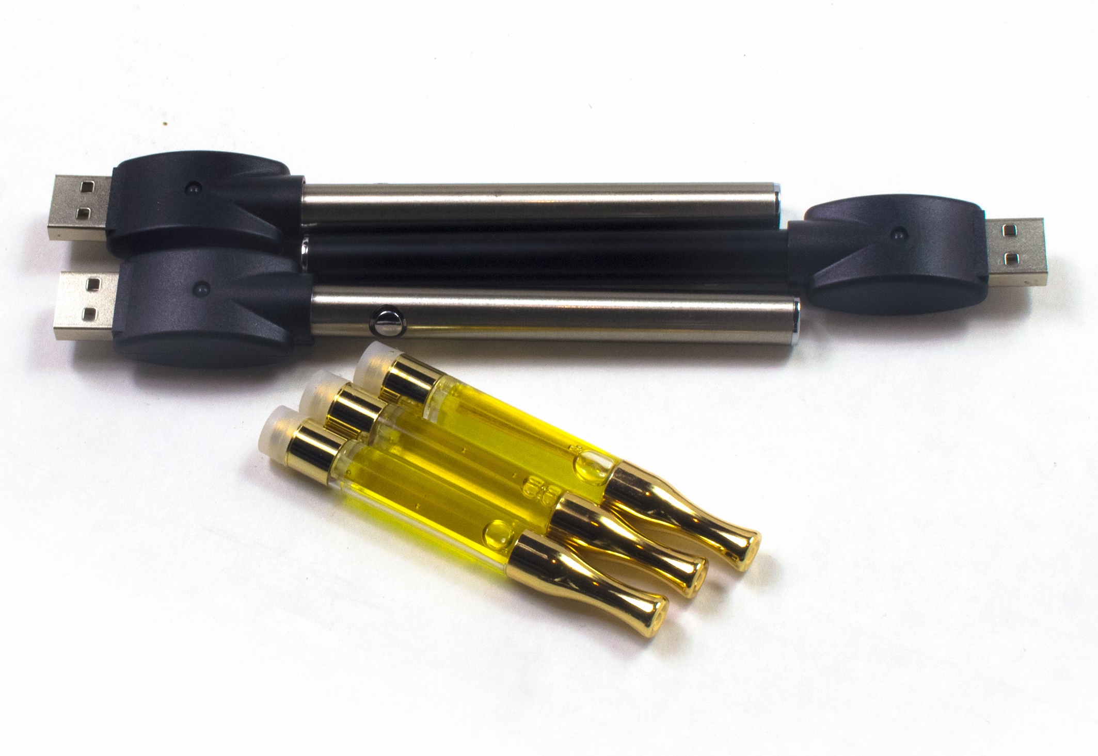
Common Vape Pen Components
Vape
Batteries
USB
Vape
Cartridges

Slide 23
Harms to Teens
The use of e-cigarettes is unsafe for kids, teens, and young adults.
Most e-cigarettes contain nicotine. Nicotine is highly addictive and can harm adolescent brain development, which continues into the early- to mid-20s.
E-cigarettes can contain other harmful substances besides nicotine.
Young people who use e-cigarettes may be more likely to smoke cigarettes in the future.
More info: https://www.cdc.gov/tobacco/basic_information/e-cigarettes/Quick-Facts-on-the-Risks-of-E-cigarettes-for-Kids-Teens-and-Young-Adults.html
Source: cdc.gov

Slide 24
More Harms To Youth
Most e-cigarettes contain nicotine, the highly addictive drug in tobacco. Nicotine is especially harmful to young people. The human brain keeps developing until around the age of 25. Using products with nicotine under age 25 can harm the part of the brain responsible for memory, attention, and learning.
More Info: https://www.cdc.gov/tobacco/features/back-to-school/e-cigarettes-talk-to-youth-about-risks/index.html
Source: cdc.gov

Slide 25
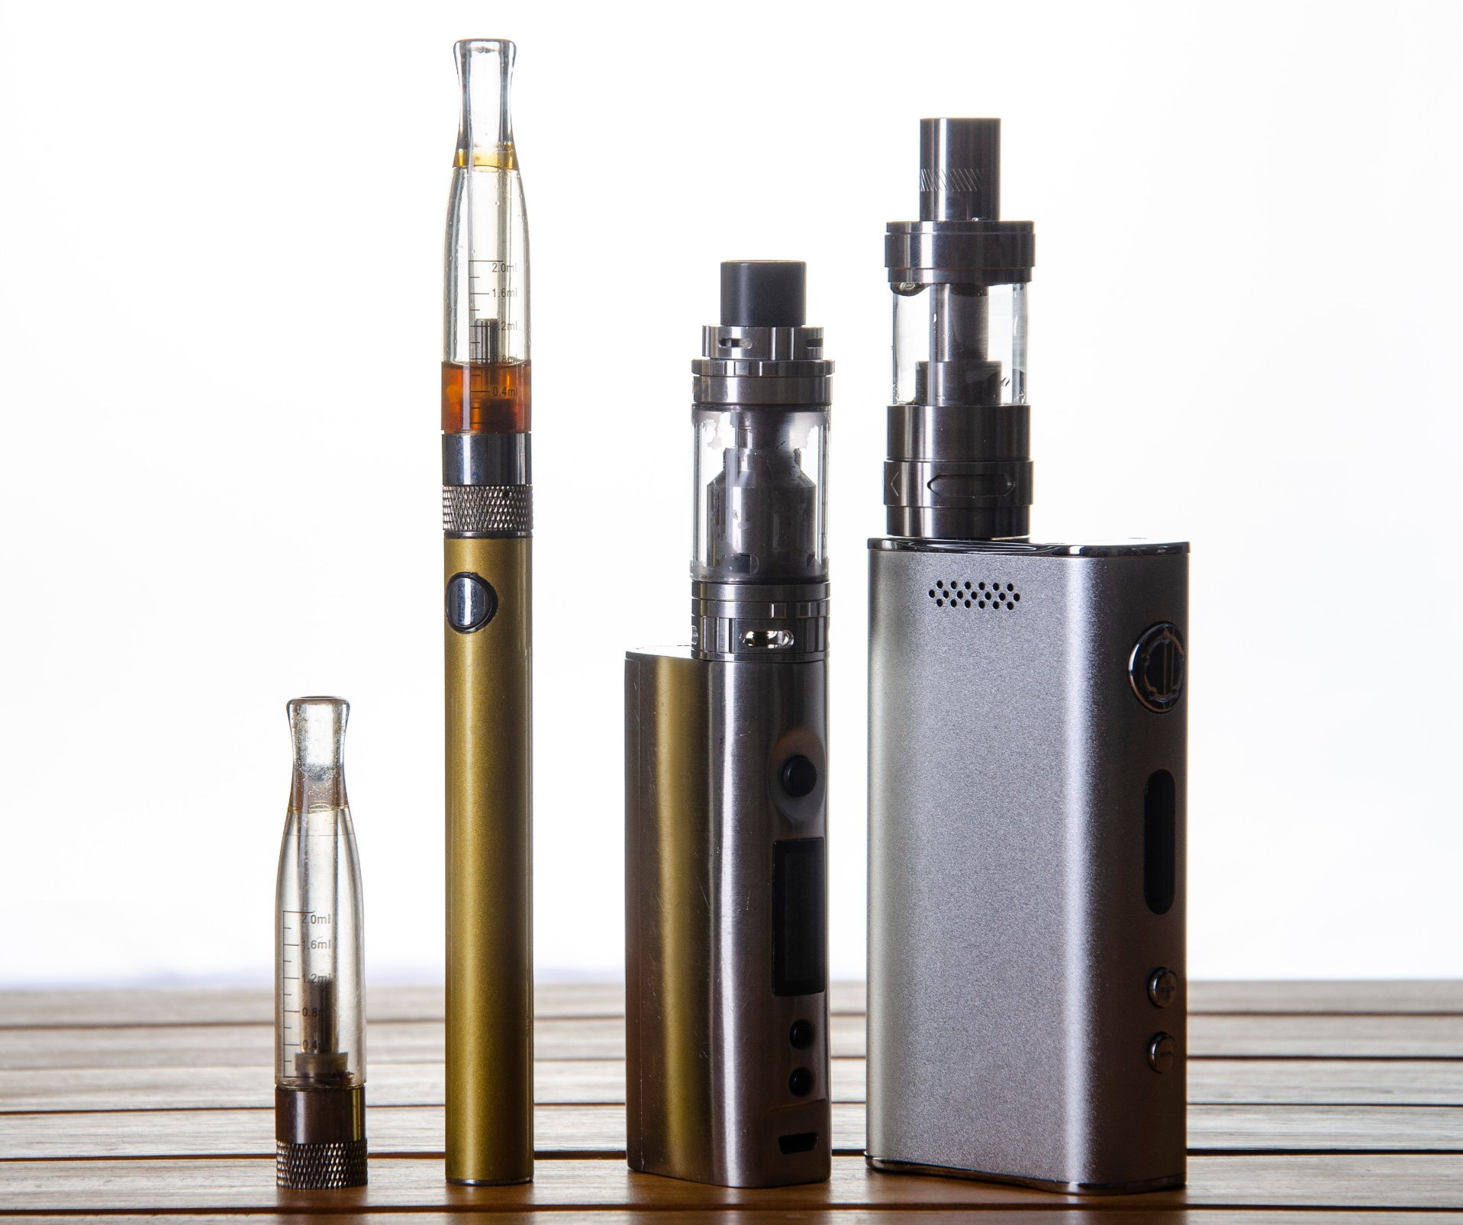
Vape Pens / E-Cigs at a Glance
VAPE
CARTRIDGE
MOUTHPIECE
VAPE BATTERY
MOD
VAPE DEVICE
MOD
VAPE DEVICE

Slide 26
Nicotine Addiction & Withdrawal
Nicotine addiction can look different from person to person. Even if you only use tobacco once in a while, you can be addicted and can have a hard time quitting.
Signs of nicotine addiction include:
Cravings, or feeling like you really need to use tobacco
Going out of your way to get tobacco
Feeling anxious or irritable if you want to use tobacco but can’t
Continuing to use tobacco because you find it hard to stop
When you’re addicted to nicotine, you may experience symptoms of nicotine withdrawal after you stop using tobacco. Craving cigarettes, feeling sad or irritable, or having trouble sleeping are some common symptoms of withdrawal. These symptoms are usually strongest in the first week after quitting, but they are only temporary.
Source: https://teen.smokefree.gov/the-risks-of-tobacco/nicotine-addiction

Slide 27
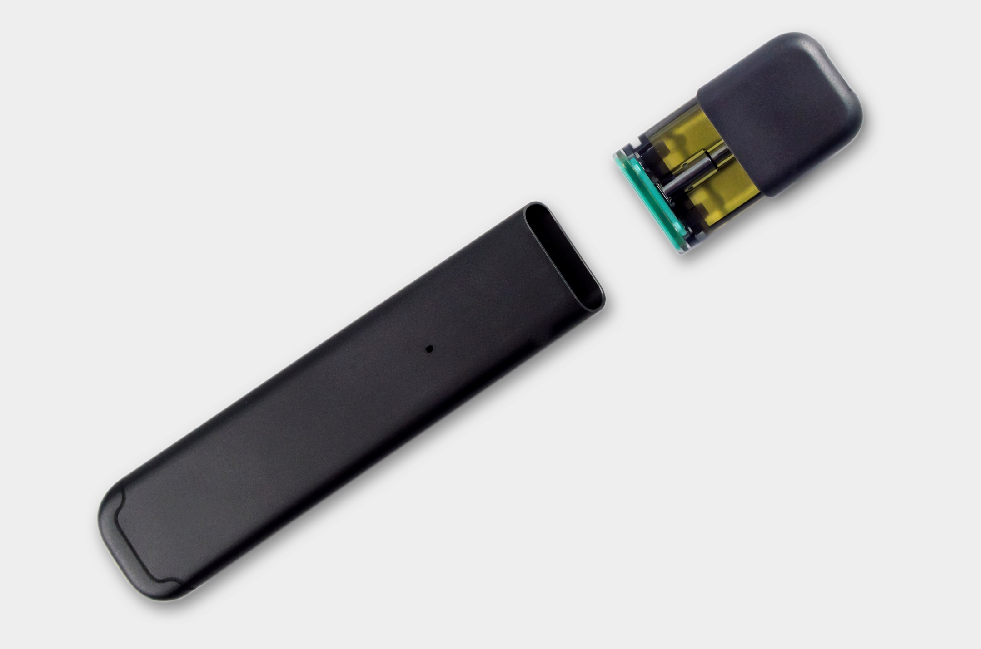
Vapes & Vape Pod Systems

Slide 28
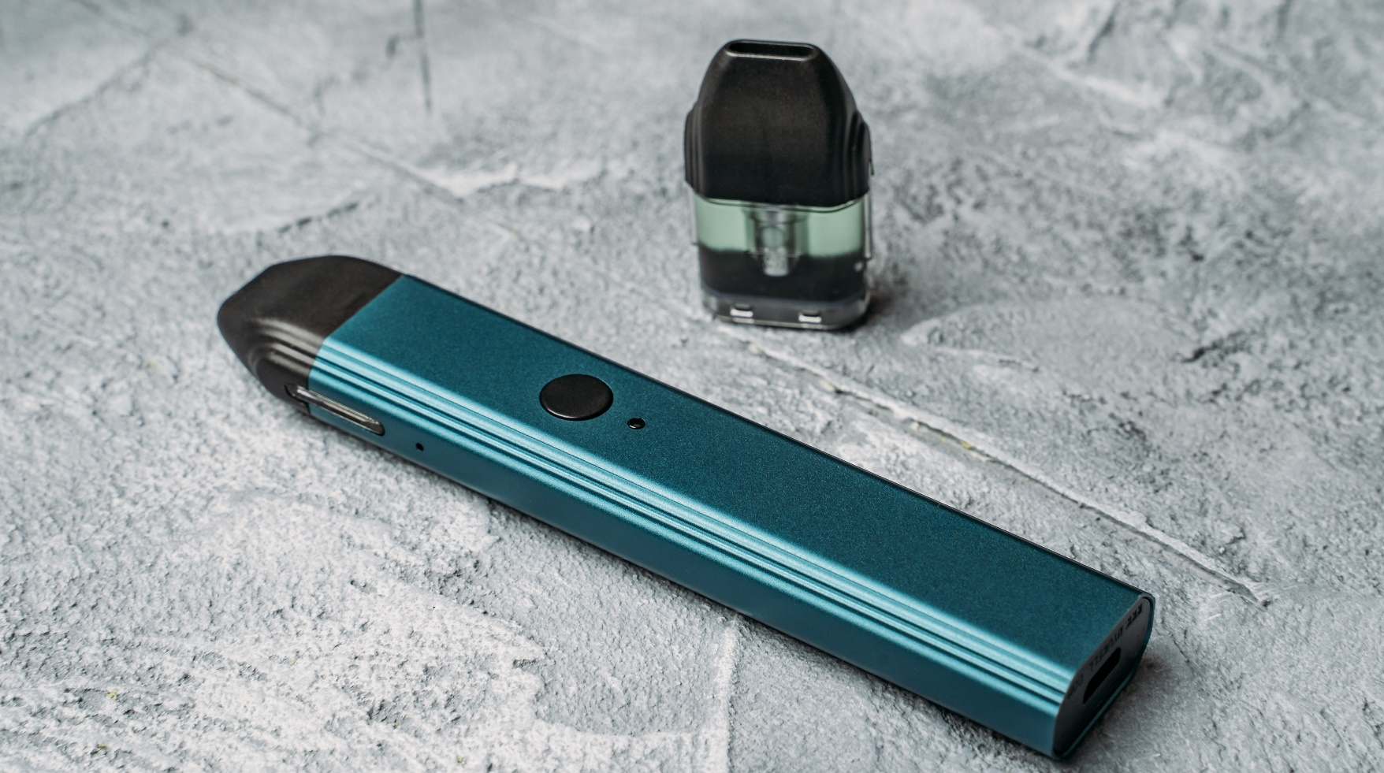
Devices With Pods
A two-part vape pen that includes a battery and a removable pod
The pod is either prefilled (generally disposable) or refillable (generally reusable).
Also known as vape pods or pod mods

Slide 29
Preloaded Vape Devices
These are preloaded disposable vape pens.
They have an approximate number of puffs, after which you throw the entire device away.
No on/off switch – you just take a draw.
Mouthpiece is attached to device.
AKA "vape stick" or "nic stick"

Slide 30
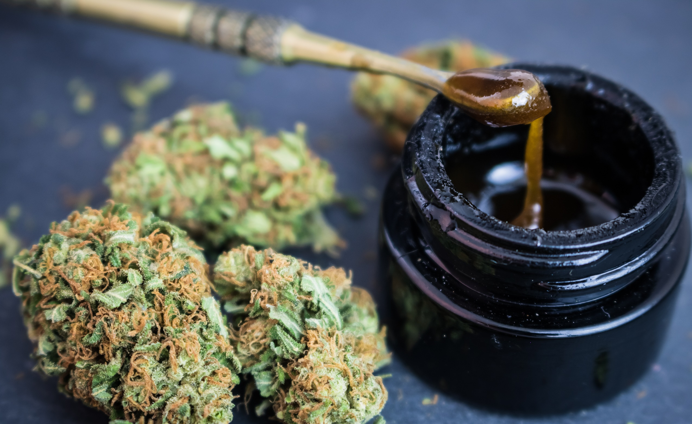
Marijuana
Traditional
Marijuana
Marijuana Wax AKA "Dab"

Slide 31
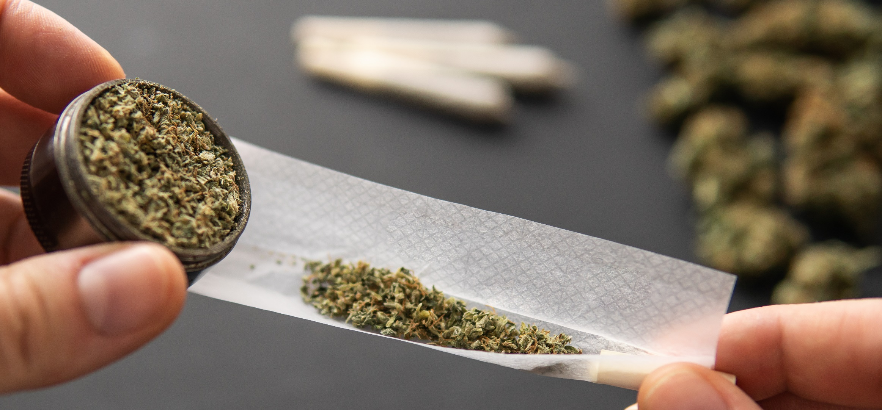
What Is Marijuana ?
Marijuana — also called weed, herb, pot, grass, bud, ganja, Mary Jane, and a vast number of other slang terms — is a greenish-gray mixture of the dried flowers of Cannabis sativa.
Source: https://www.dea.gov/factsheets/marijuana

Slide 32
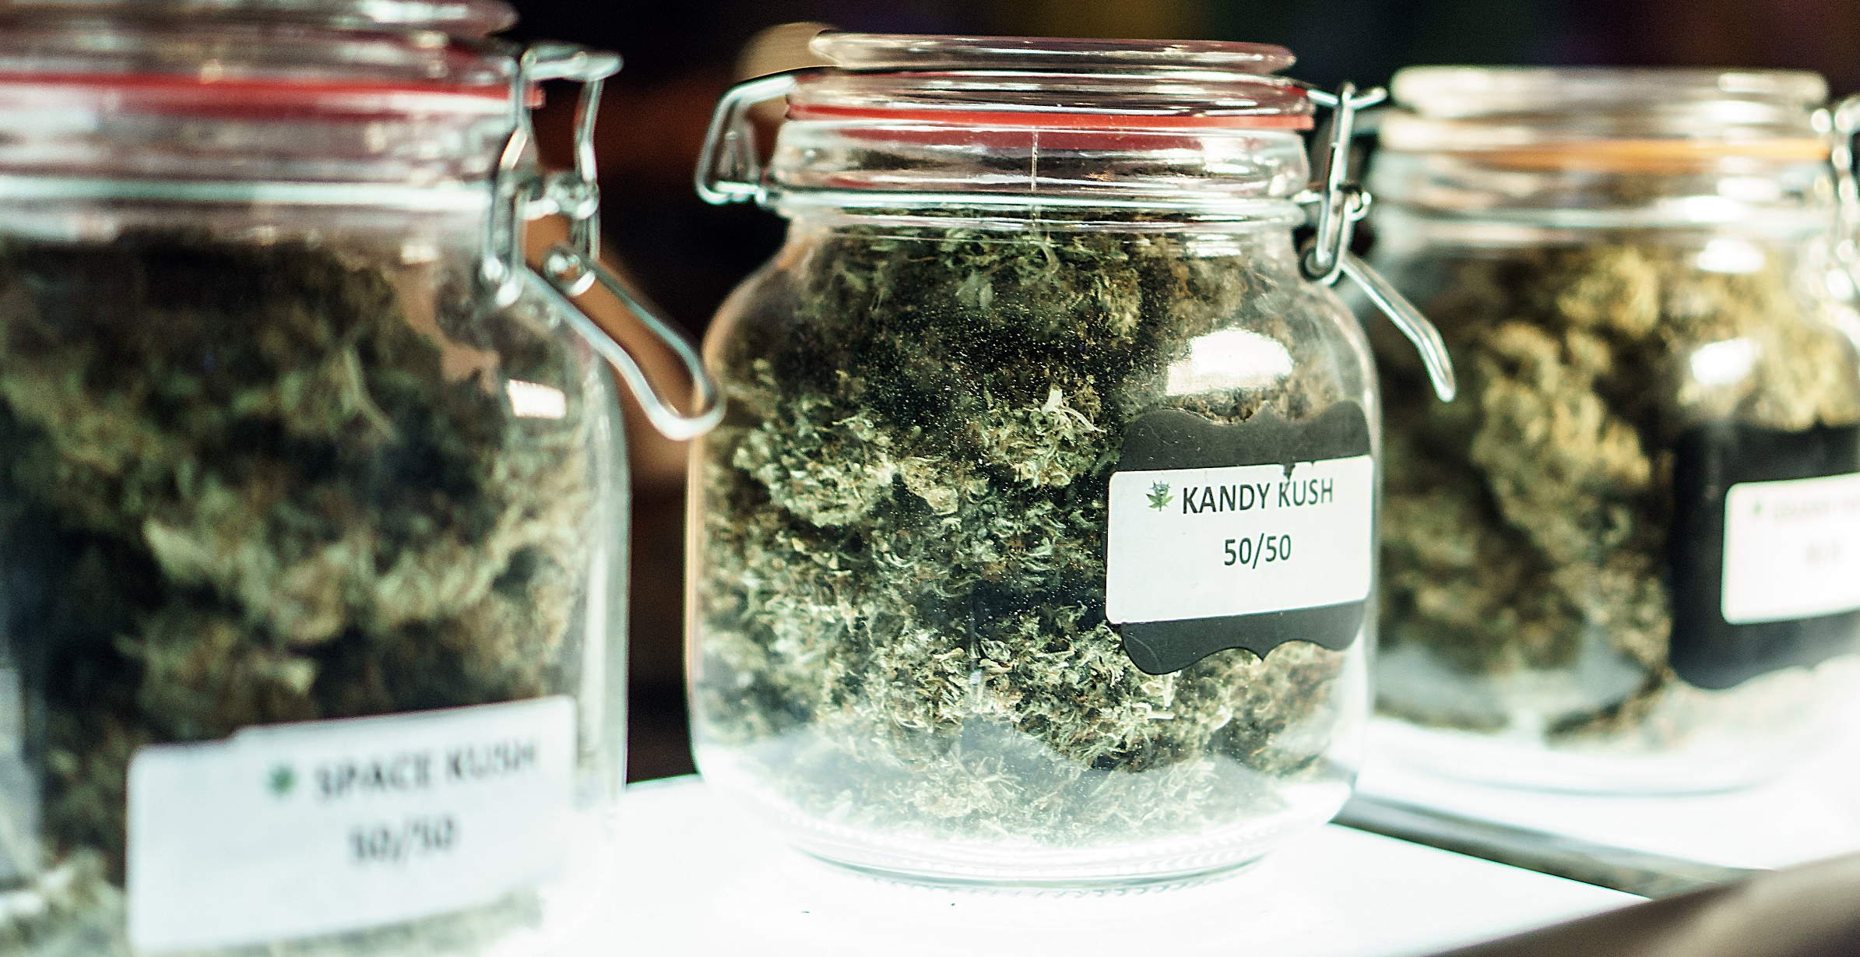
Marijuana Strains
The forms of marijuana can fall under various names, which are known as strains.

Slide 33
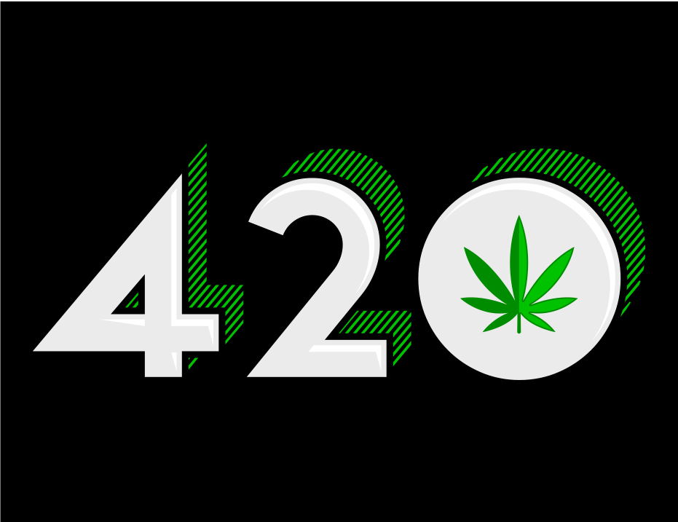
April 20 (4/20) Is Known As the National "Stoner" Holiday

Slide 34
Marijuana Use & Youth
Marijuana, like some other brain-altering substances, can be addictive. Nearly one in 10 marijuana users will become addicted. Signs that someone might be addicted include being unable to stop using marijuana, using it even though they know it is causing problems, and using marijuana instead of joining important activities with friends and family. People who frequently use marijuana often report withdrawal symptoms.
These symptoms include being irritable or restless, having a small appetite, experiencing cravings, and problems with mood and sleep. These symptoms can last up to two weeks after the last use. In 2015, about four million people in the United States met the standards for being diagnosed with a marijuana use disorder.
Source: https://www.hhs.gov/ash/oah/adolescent-development/substance-use/ marijuana/risks/index.html

Slide 35
Marijuana Use & Youth
(continued)
Starting to use marijuana at a younger age can lead to a greater risk of developing a substance use disorder later in life. Adolescents who begin using marijuana before age 18 are four to seven times more likely than adults to develop a marijuana use disorder.
Source: https://www.hhs.gov/ash/oah/adolescent-development/substance-use/ marijuana/risks/index.html

Slide 36
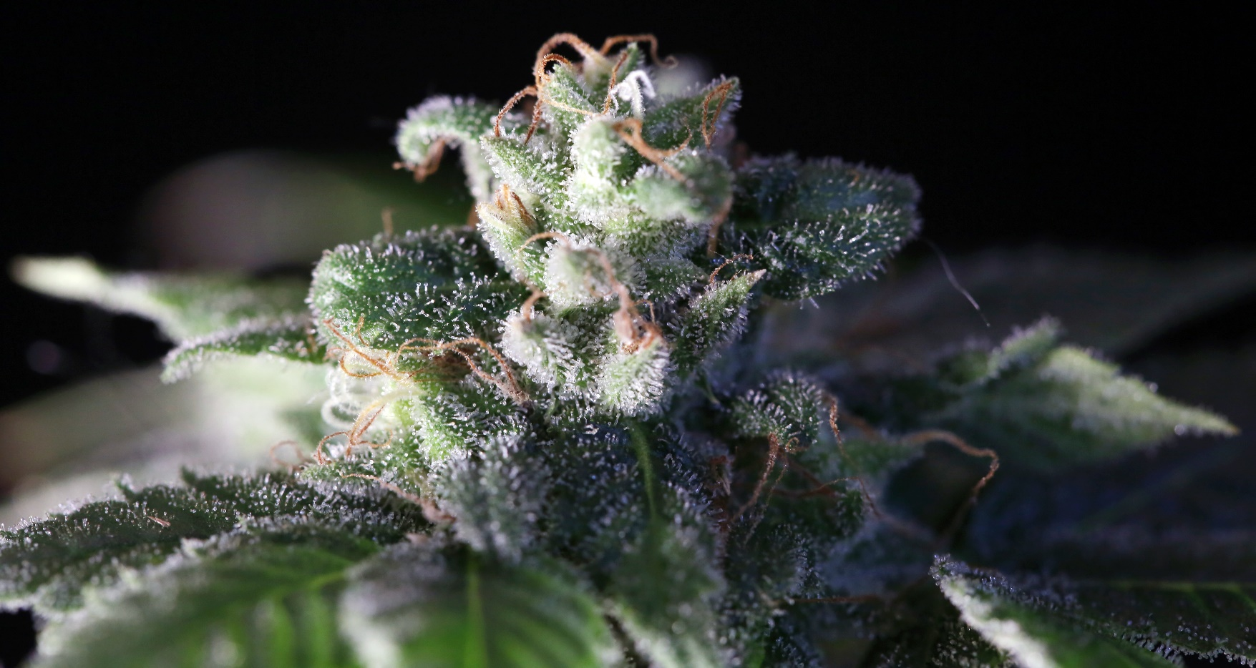
Ways to Ingest Marijuana
Smoke it from a bong, pipe, joint, or blunt
Vape
Edibles (in food or drink)
Dabbing (concentrated form)

Slide 37
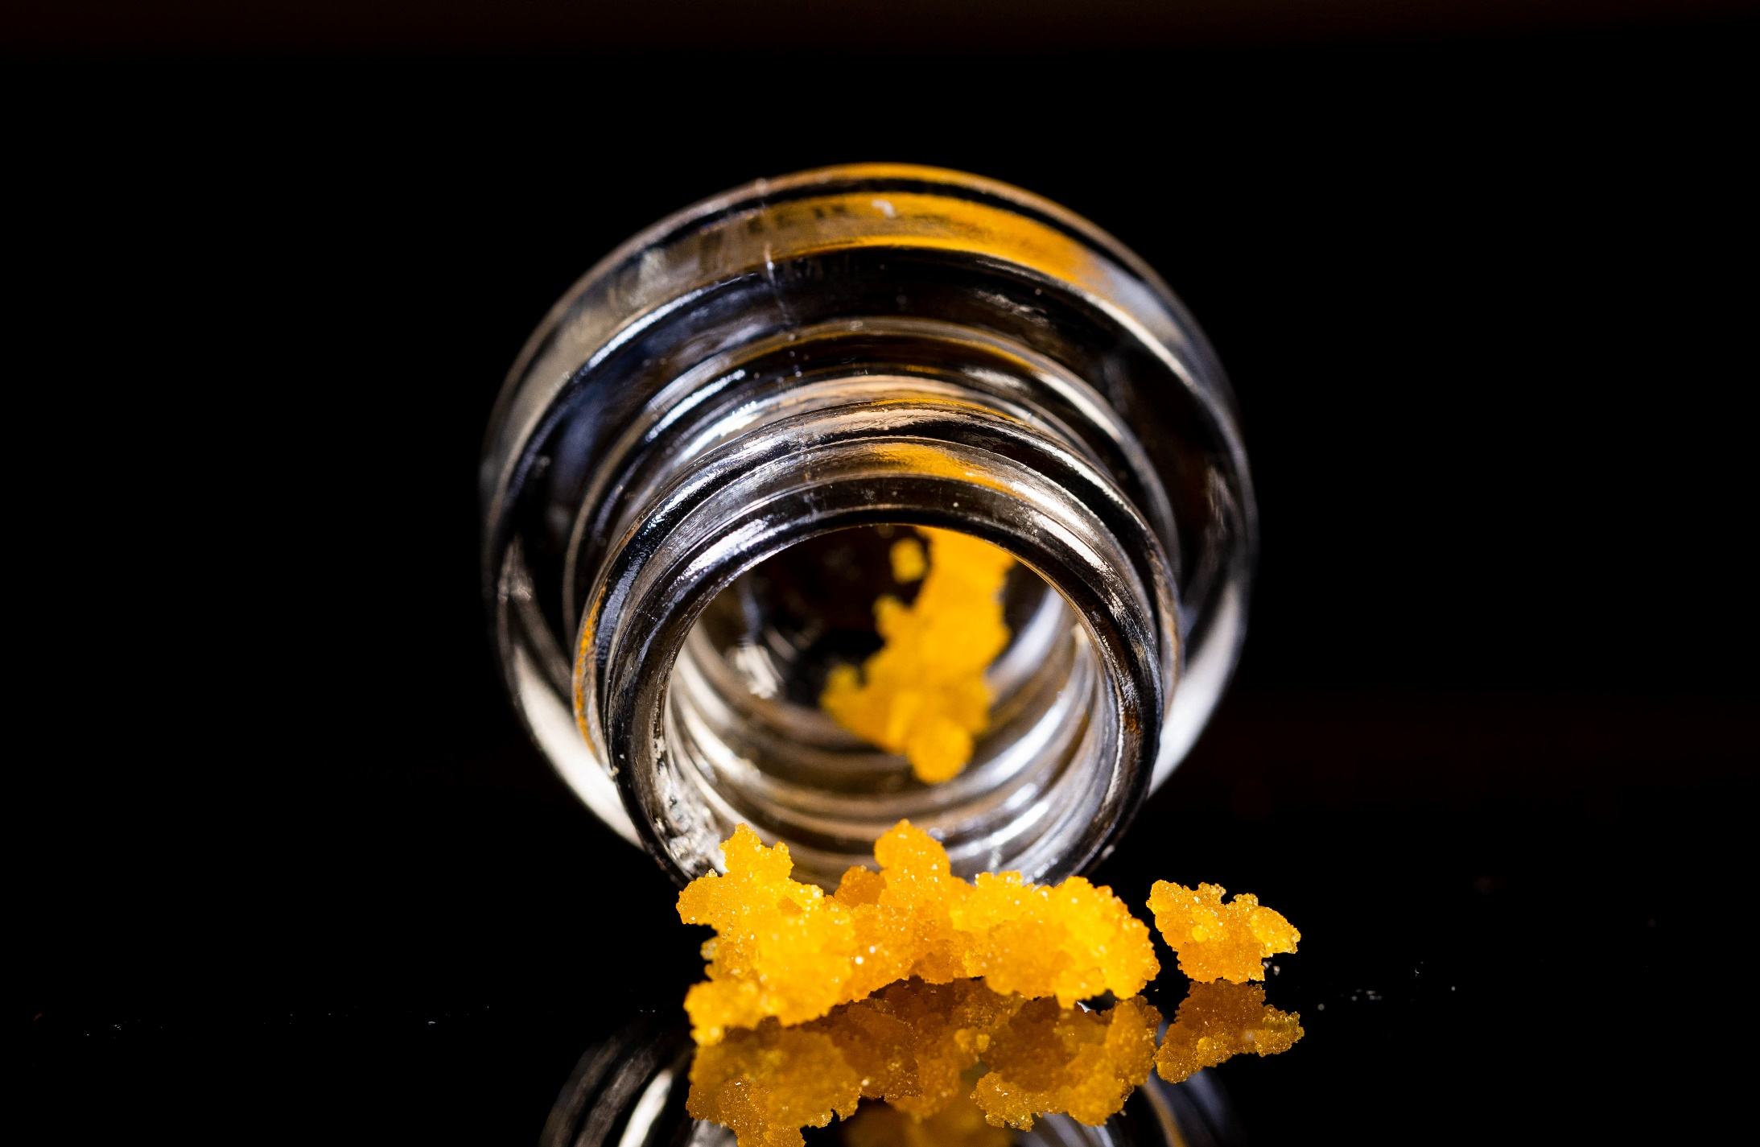
New Forms of Marijuana

Slide 38
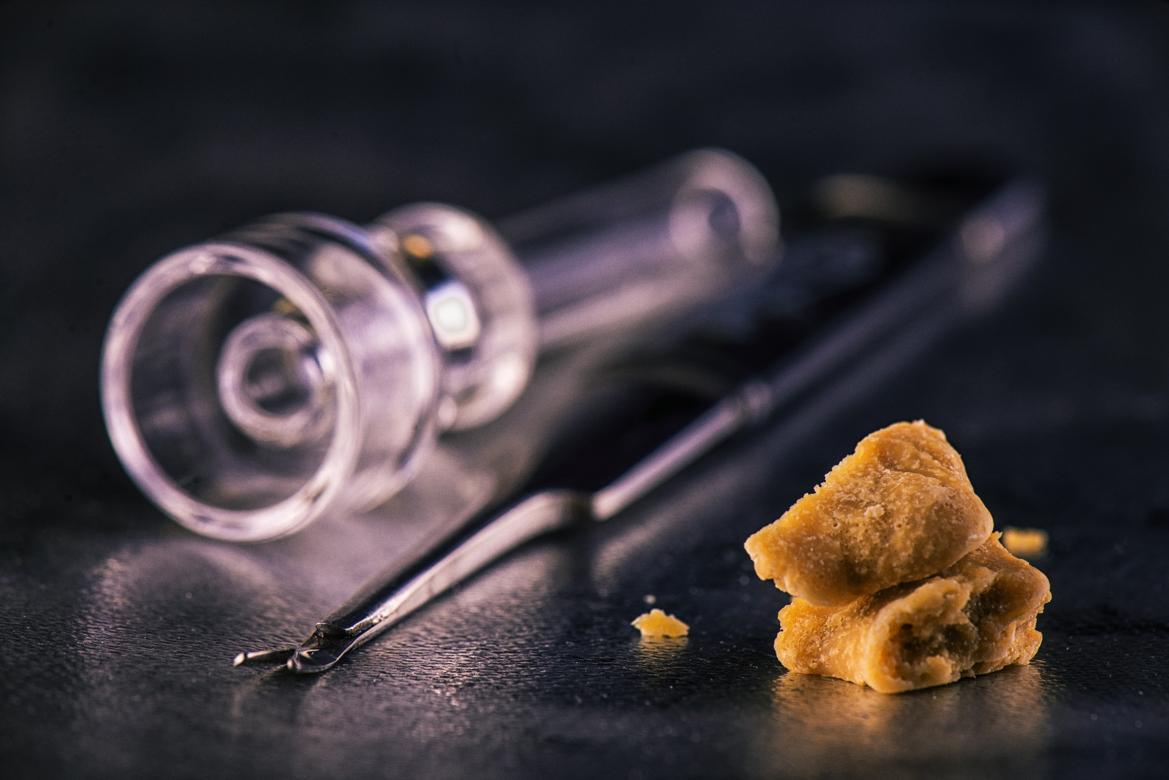
Marijuana Concentrates AKA "Dabs"
Street Names: dabs, concentrates, wax, ear wax, oil, essential oils (with THC), extracts

Slide 39
Marijuana Concentrates AKA "Dabs"
Smoking THC-rich resins extracted from the marijuana plant is on the rise. People call this practice "dabbing."
These extracts come in various forms, such as:
"hash oil" or "honey oil" — a gooey liquid
"wax" or "budder" — a soft solid with a texture like lip balm
"Shatter" — a hard, amber-colored solid
Source: https://www.drugabuse.gov/publications/drugfacts/marijuana

Slide 40
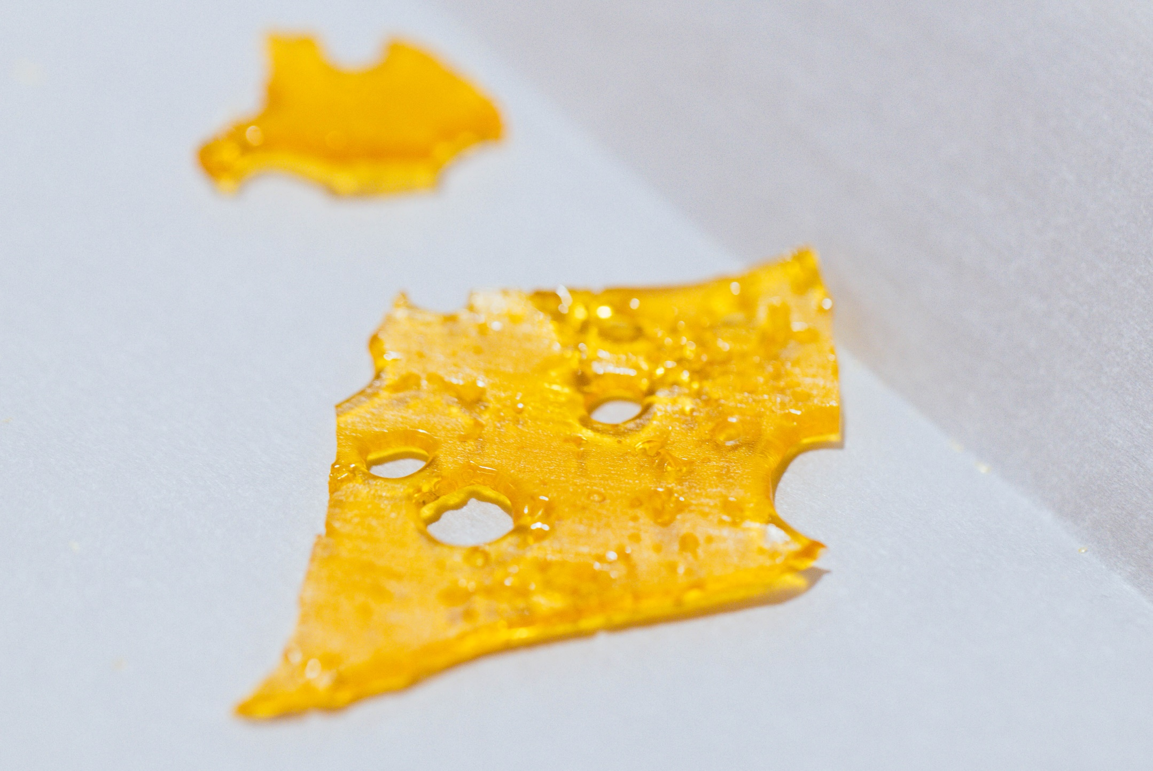
Marijuana Shatter

Slide 41
Shatter Details
Some forms of shatter have as much as 90% THC, the psychoactive ingredient in marijuana. That is about five times the potency of unrefined smoked marijuana. It is more powerful than standard hash oil. Shatter is a thin, hard layer that is similar to glass. It can shatter if dropped.
Source: https://drugfree.org/drug-and-alcohol-news/ law-enforcement-sees-high-potency-marijuana-called-shatter/

Slide 42
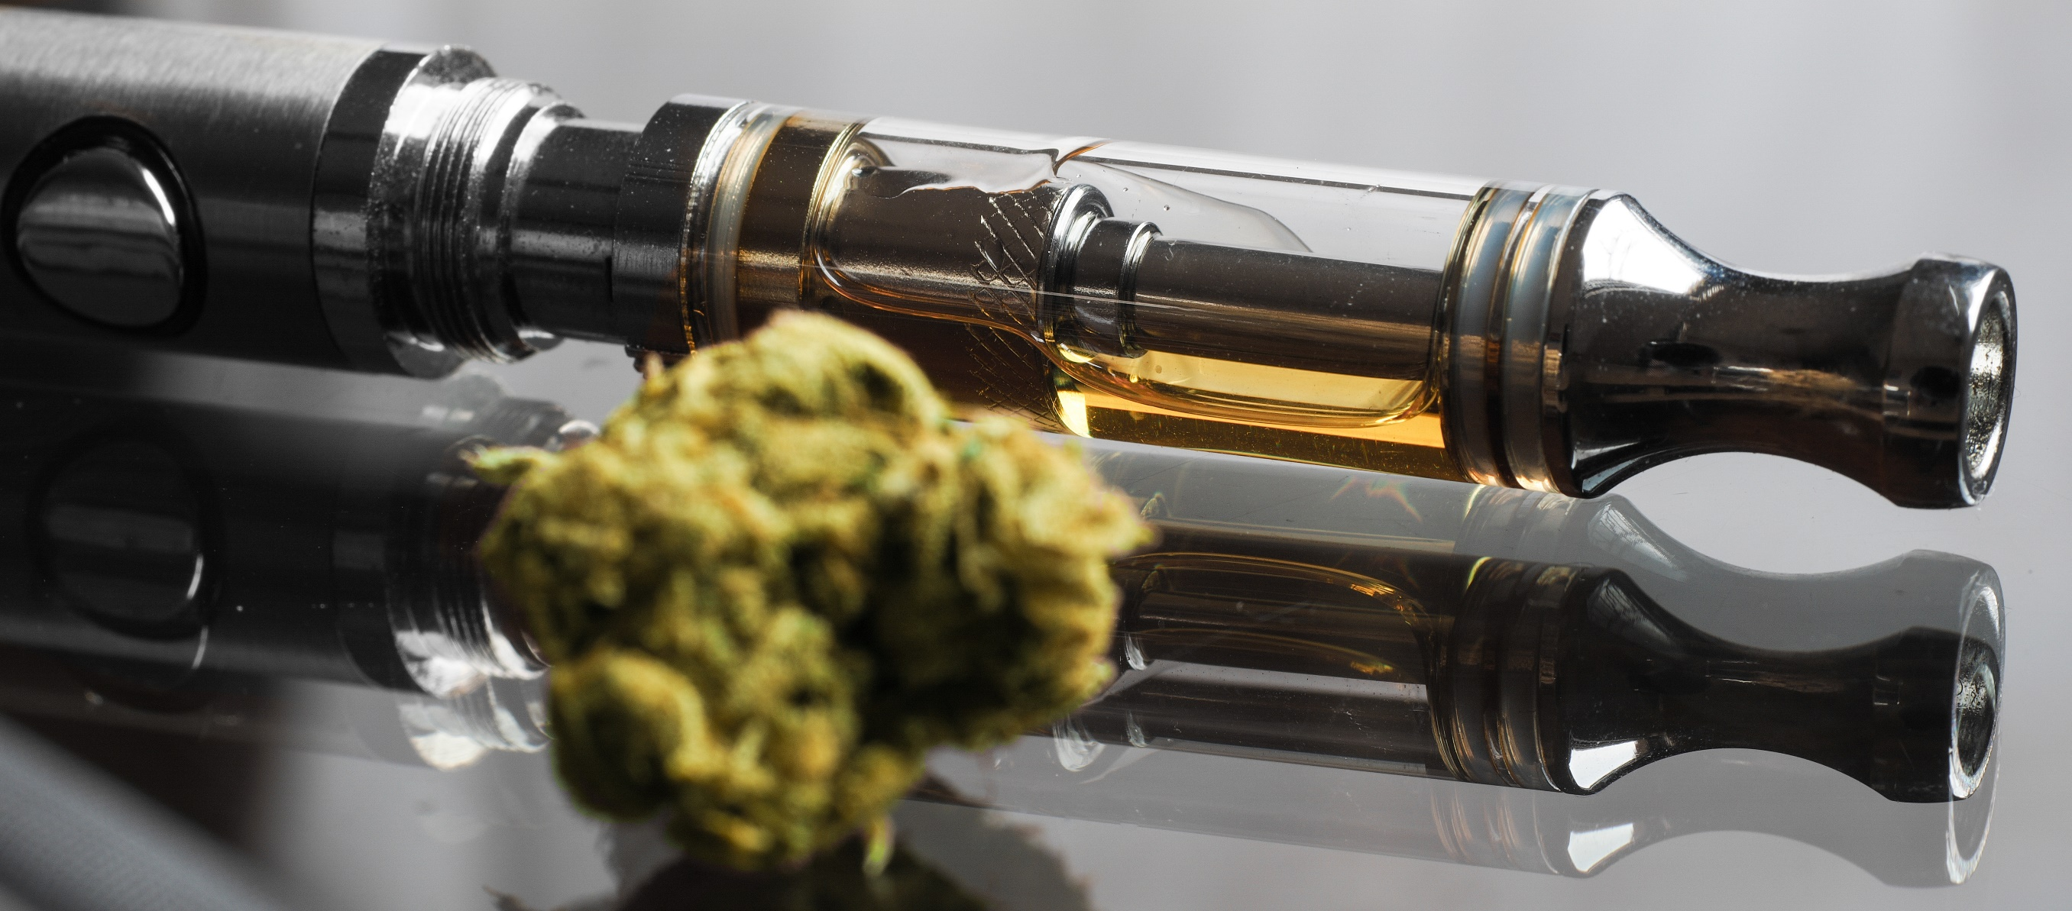
Marijuana (THC) Vapes

Slide 43
Marijuana Vapes
Marijuana vapes can be hard to distinguish from some nicotine vapes.
Many can work for:
Dry leaf marijuana
Dabs or concentrated forms of marijuana
Marijuana oils

Slide 44
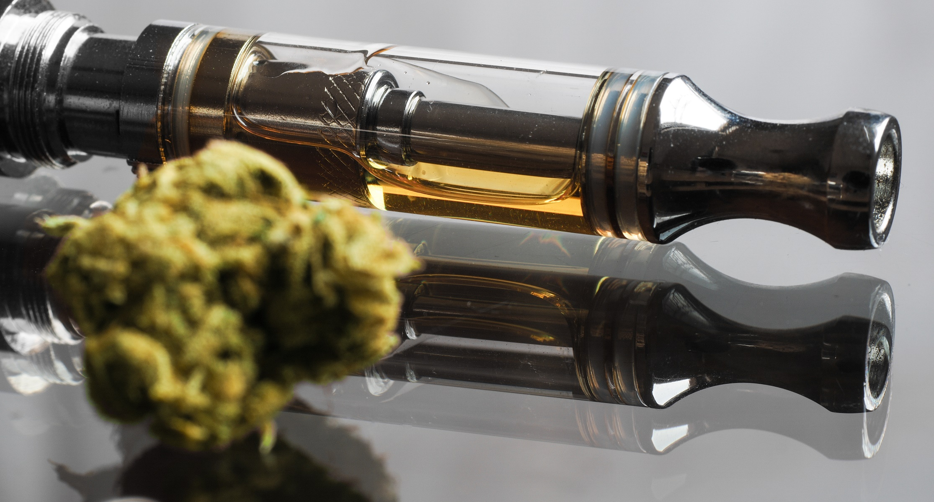
Various cannabis vapes can use a leaf form while others can use an oil form.

Slide 45
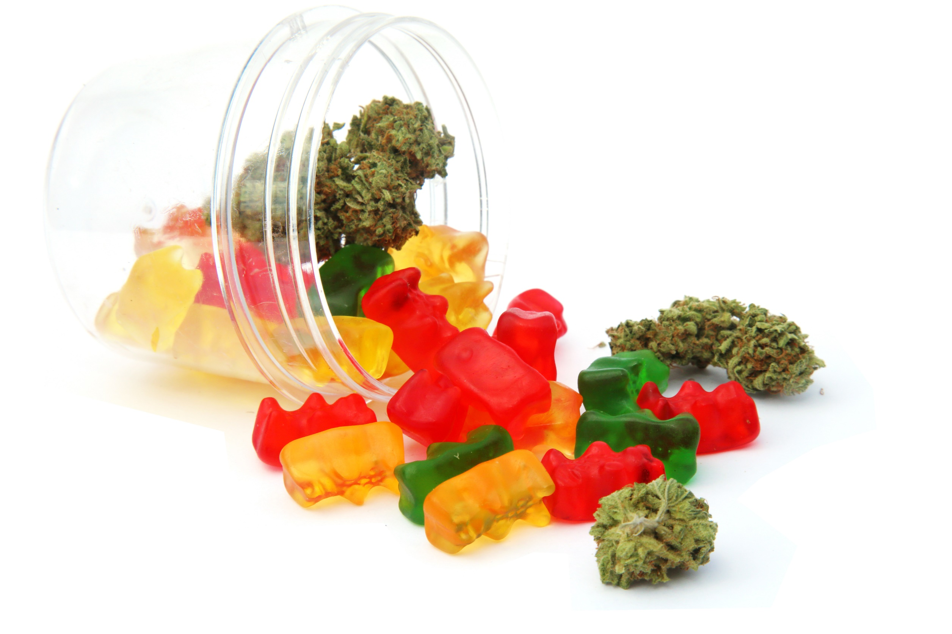
Marijuana Edibles

Slide 46
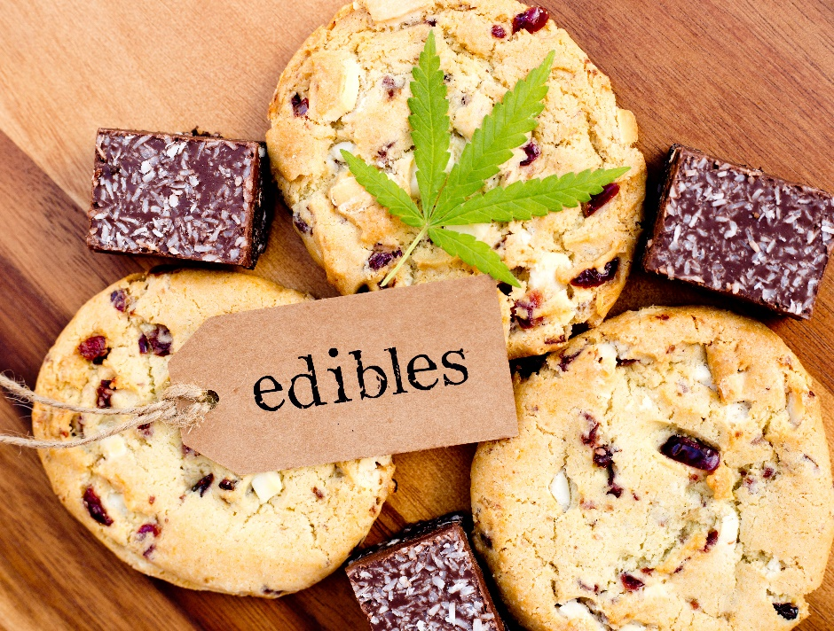
Marijuana Edibles
Marijuana edibles are food and drink products infused with cannabis extracts. These edibles are made with marijuana or marijuana oils. The products can be made at home or through commercial production.
Marijuana edibles come in many forms:
Gummy candies, hard candy, and chocolate
Sodas and flavored juices
Powders
Brownies, cookies, and various treats
Items can look like cereal, granola bars, and more.

Slide 47
Youth and Marijuana Edibles
A new analysis suggests that among adolescent marijuana users, smoking marijuana has become less prevalent, eclipsed by vaping and edibles. In addition, those who vaped THC or consumed edibles were more likely to use marijuana daily. The findings were just published as a Research Letter in JAMA Pediatrics.
Source: https://www.drugabuse.gov/news-events/latest-science/marijuana-vaping-edible-use-increasing-among-high-school-seniors

Slide 48
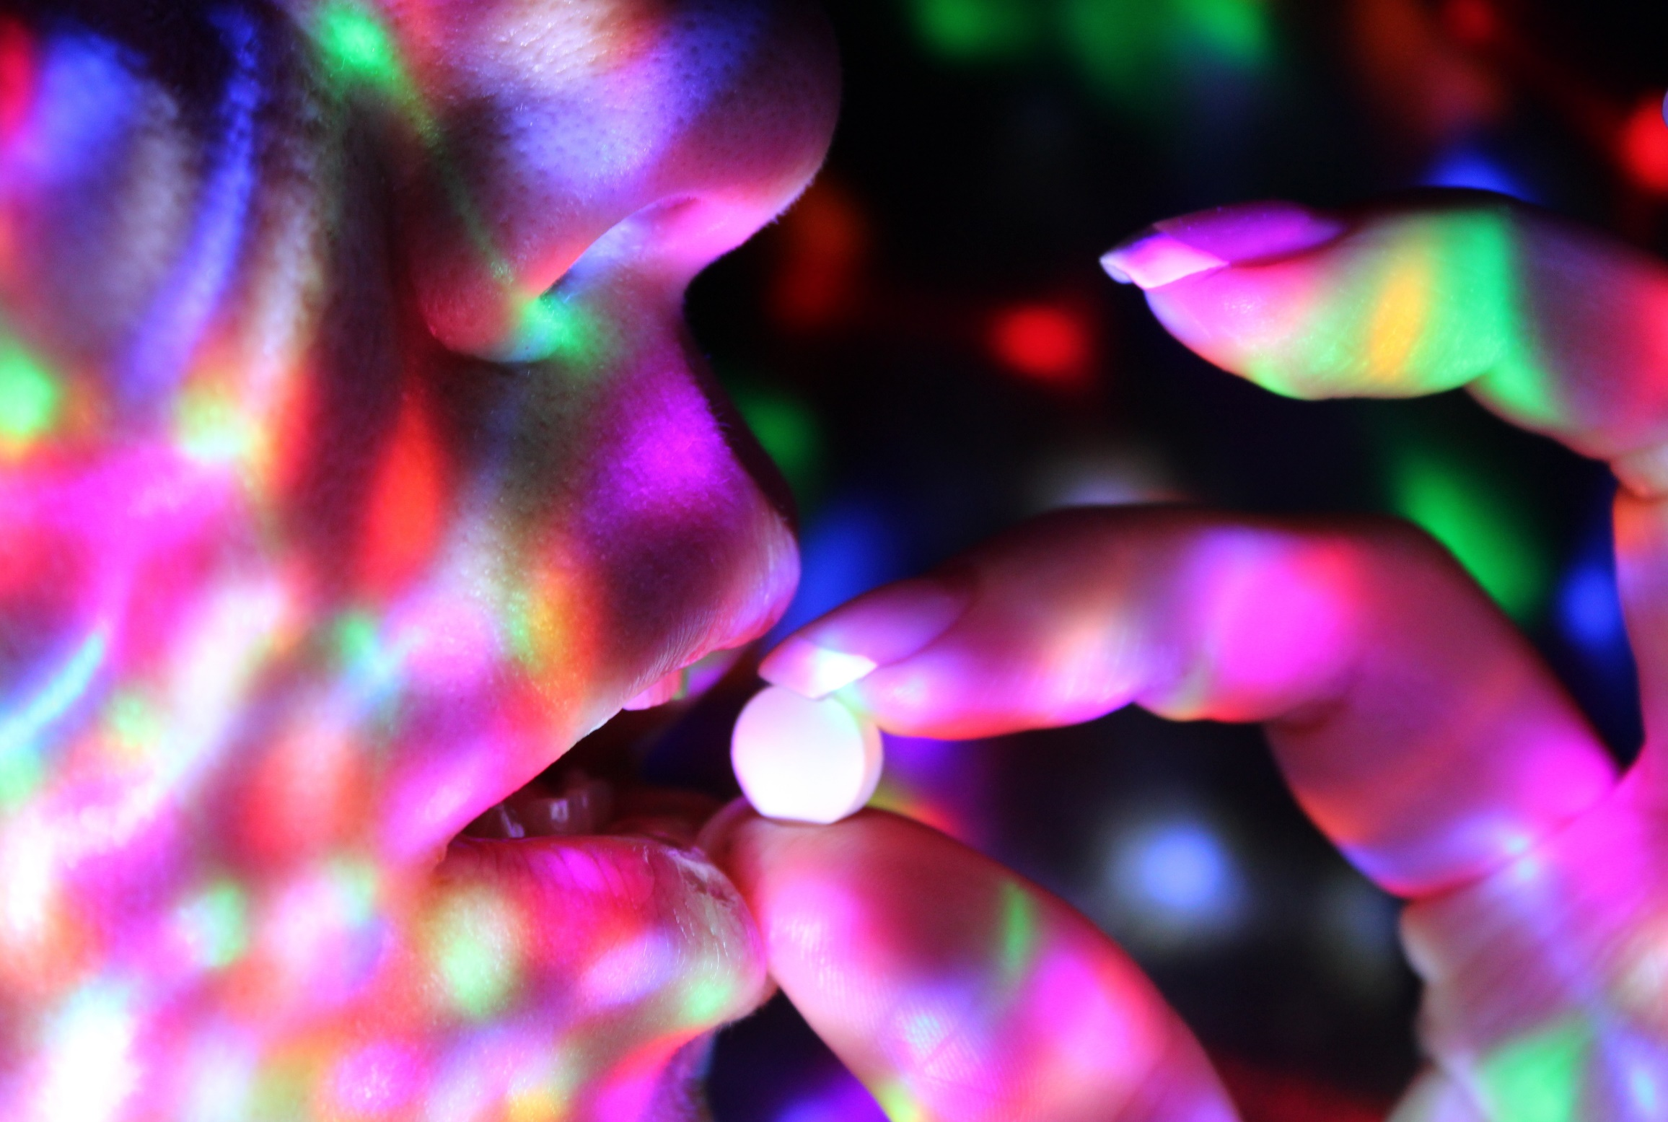
YOUTH PRESCRIPTION DRUG USE

Slide 49
Prescription Medications
What Are Prescription Medications?
When used as prescribed by a doctor, prescription medicines can be helpful in treating many illnesses:
Stimulants are helpful in managing attention-deficit hyperactivity disorder (ADHD) and narcolepsy.
Depressants treat anxiety, panic, and sleep disorders.
Opioids are prescribed to treat pain, coughing, and diarrhea.
But when these medicines are misused, they can have serious consequences.
Source: drugabuse.gov

Slide 50
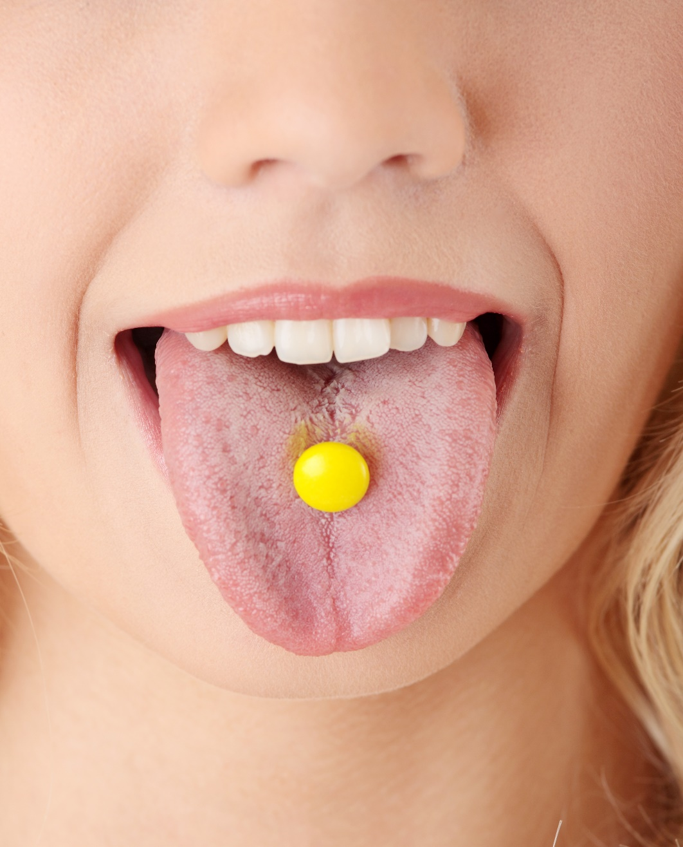
Drug Misuse & Abuse Impacting Teens
A common misperception is that prescription drugs are safer or less harmful to one's body than other kinds of drugs. However, there is a range of short- and long-term health consequences for each type of prescription drug used inappropriately.
Source: samhsa.gov

Slide 51
Drug Misuse & Abuse Impacting Teens
(continued)
Stimulants have side effects in common with cocaine that may include paranoia, dangerously high body temperatures, and an irregular heartbeat, especially if stimulants are taken in large doses or in ways other than swallowing a pill.
Opioids, which act on the same parts of the brain as heroin, can cause drowsiness, nausea, constipation, and, depending on the amount taken, slowed breathing.
Depressants can cause slurred speech, shallow breathing, fatigue, disorientation, lack of coordination, and seizures upon withdrawal from chronic use.
Source: samhsa.gov

Slide 52
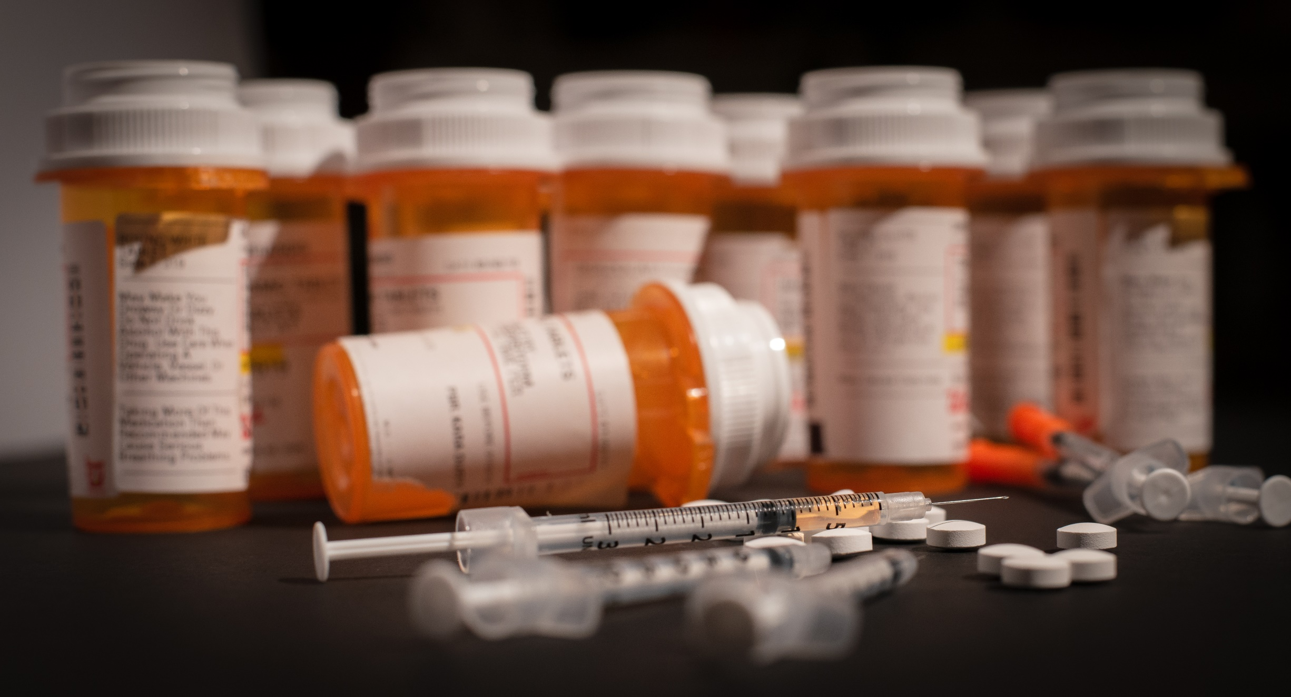
Opioid Abuse

Slide 53
What Are Opioids ?
Opioids are a class of drugs that include the illegal drug heroin, synthetic opioids such as fentanyl, and pain relievers available legally by prescription, such as oxycodone (OxyContin®), hydrocodone (Vicodin®), codeine, morphine, and many others.
When used correctly under a healthcare provider's direction, prescription pain medicines are helpful. However, misusing prescription opioids risks dependence and addiction.
Source: hhs.gov/opioids

Slide 54
Opioid Information
Opioids can cause side effects such as drowsiness, mental fog, nausea, and constipation. They may also cause slowed breathing, which can lead to overdose deaths. If someone has signs of an overdose, call 911:
The person's face is extremely pale and/or feels clammy to the touch.
Their body goes limp.
Their fingernails or lips have a purple or blue color.
They start vomiting or making gurgling noises.
They cannot be awakened or are unable to speak.
Their breathing or heartbeat slows or stops.
Source: https://medlineplus.gov/opioidmisuseandaddiction.html#summary

Slide 55
Opioid Dependence & Withdrawal
Other risks of using prescription opioids include dependence and addiction. Dependence means feeling withdrawal symptoms when not taking the drug. Addiction is a chronic brain disease that causes a person to compulsively seek out drugs, even though they cause harm. The risks of dependence and addiction are higher if you misuse the medicines. Misuse can include taking too much medicine, taking someone else's medicine, taking it in a different way than you are supposed to, or taking the medicine to get high.
Source: https://medlineplus.gov/opioidmisuseandaddiction.html#summary

Slide 56
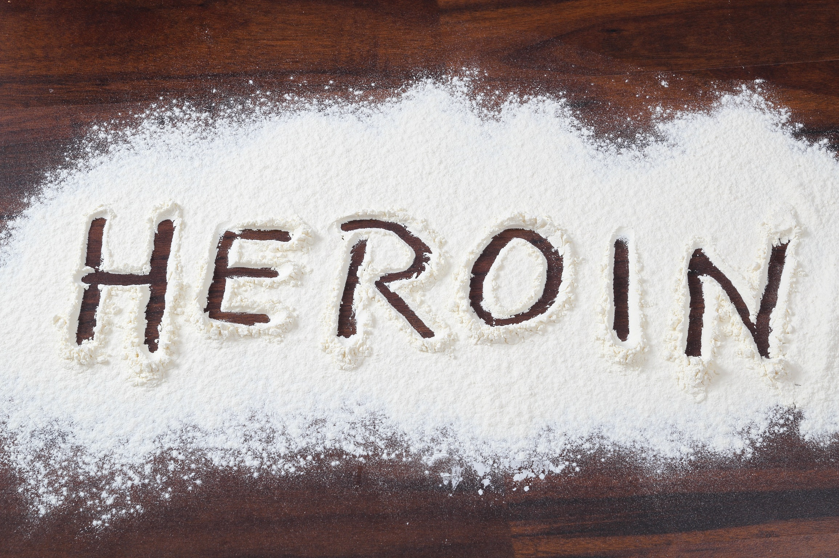
HEROIN USE

Slide 57
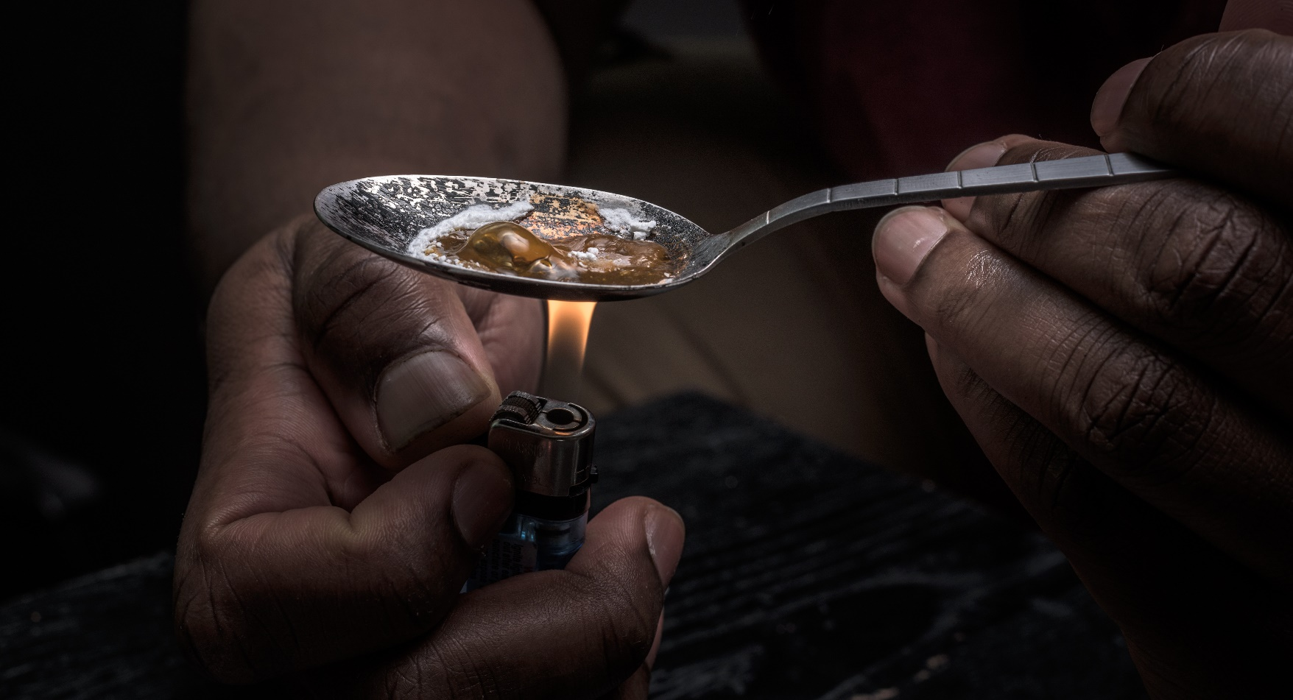
Heroin
Heroin is an opioid drug made from morphine, a natural substance taken from the seed pod of the various opium poppy plants grown in Southeast and Southwest Asia, Mexico, and Colombia. Heroin can be a white or brown powder, or a black sticky substance known as "black tar heroin." Other common names for heroin include big H, horse, hell dust, and smack.
Source: https://www.drugabuse.gov/publications/drugfacts/heroin

Slide 58
Heroin Use & Abuse
People inject, sniff, snort, or smoke heroin. Some people mix heroin with crack cocaine, a practice known as speedballing.
Heroin enters the brain rapidly and binds to opioid receptors on cells located in many areas, especially those involved in feelings of pain and pleasure and in controlling heart rate, sleeping, and breathing.
Source: https://www.drugabuse.gov/publications/drugfacts/heroin

Slide 59
Heroin’s Long-Term Effects
People who use heroin over the long term may develop:
insomnia
collapsed veins for people who inject the drug
damaged tissue inside the nose for people who sniff or snort it
infection of the heart lining and valves
abscesses (swollen tissue filled with pus)
constipation and stomach cramping
liver and kidney disease
lung complications, including pneumonia
mental disorders such as depression and antisocial personality disorder
sexual dysfunction for men
irregular menstrual cycles for women
Source: https://www.drugabuse.gov/publications/drugfacts/heroin

Slide 60
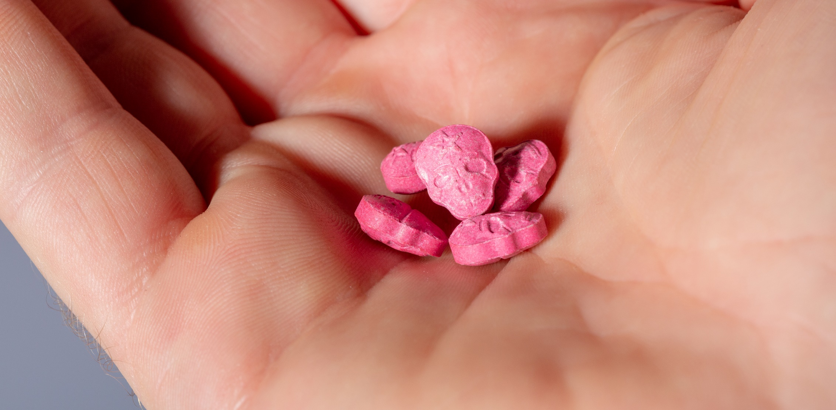
ECSTASY

Slide 61
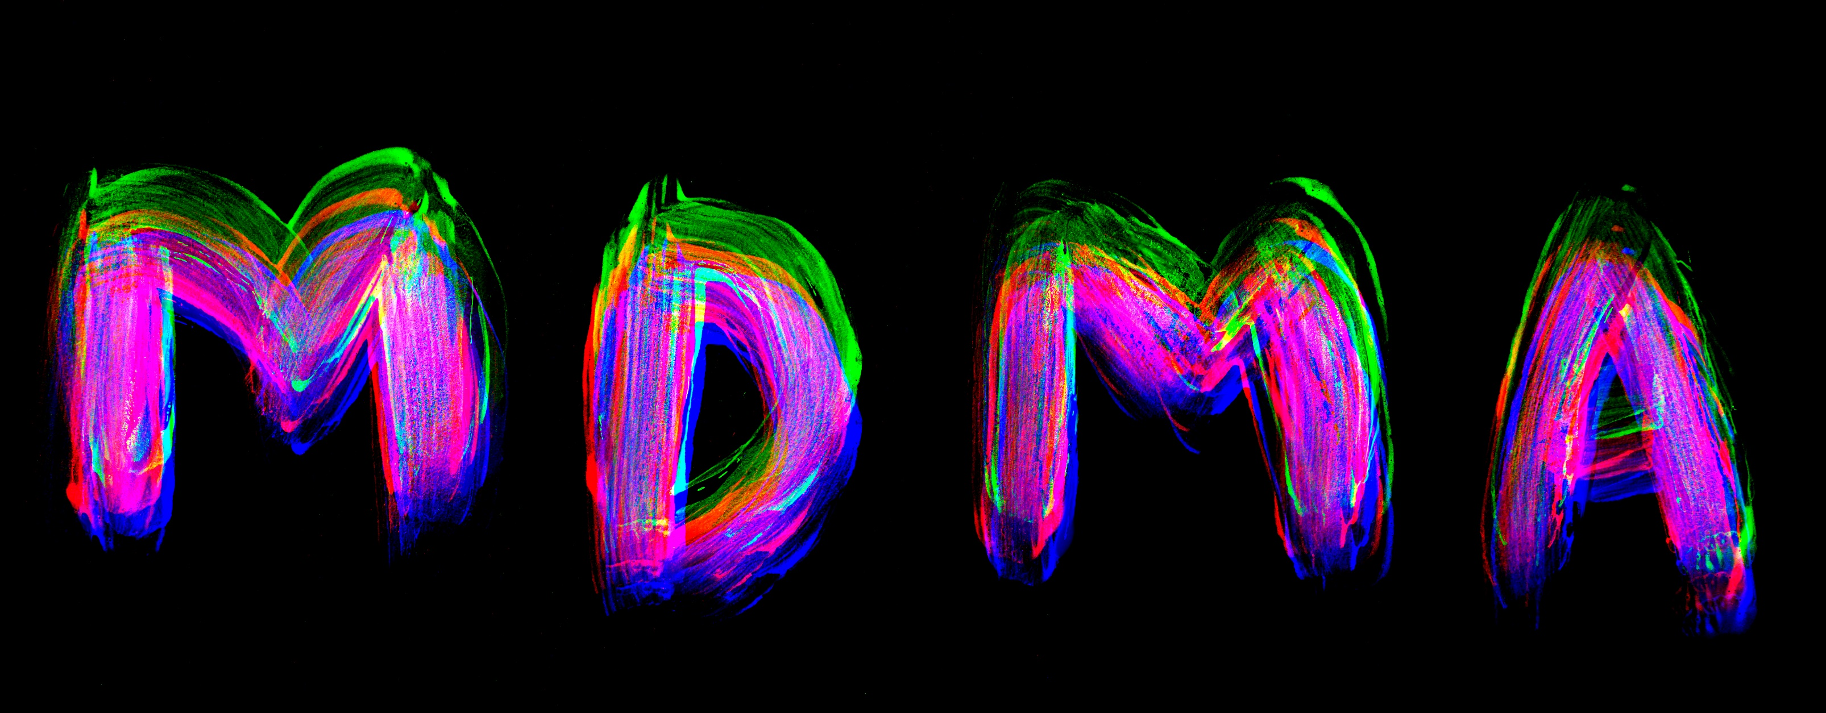

Slide 62
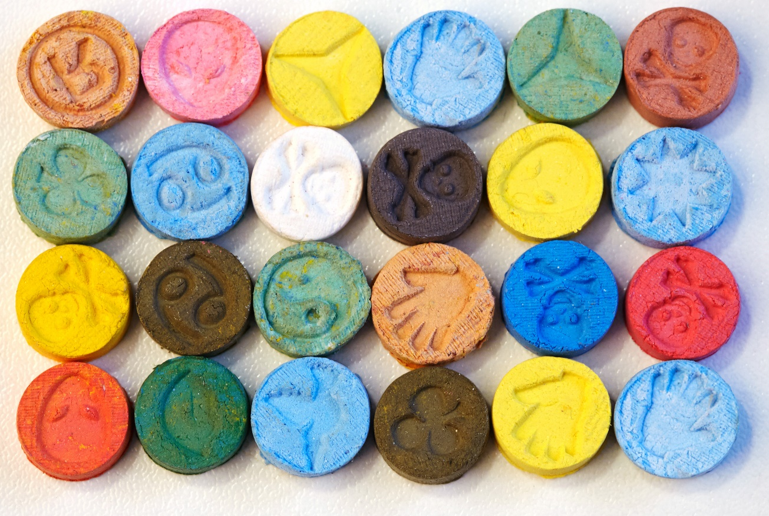
Ecstasy
Also known as Molly or MDMA.
MDMA is methylenedioxymethamphetamine, a synthetic (lab-made) drug.
Frequently comes in a pill form but can also be in a powder form.
Frequently contains other ingredients.

Slide 63
MDMA Effects
Some users experience negative effects from MDMA use. They may become anxious and agitated, become sweaty, have chills, or feel faint or dizzy.
Even those who don't feel negative effects during use can experience bad after-effects. Even weeks later, people can experience confusion, depression, sleep problems, drug craving, and anxiety, because the surge of serotonin caused by MDMA reduces the brain's supply of this important chemical.
Source: https://teens.drugabuse.gov/drug-facts/mdma-ecstasy-or-molly

Slide 64
Ecstasy High
Ecstasy is both a hallucinogenic and a stimulant drug. It makes users experience a rush of good feelings (a high) and makes feelings much more intense, whether they're good or bad. The drug's effects usually last up to six hours.
Ecstasy increases heart rate and can cause dry mouth, clenched teeth, blurred vision, chills, sweating, or nausea. It can make some users feel anxious, confused, and paranoid, like someone is trying to hurt them or is plotting against them. Ecstasy may damage brain cells that are involved in thinking and memory.
Source: https://kidshealth.org/en/teens/ecstasy.html

Slide 65
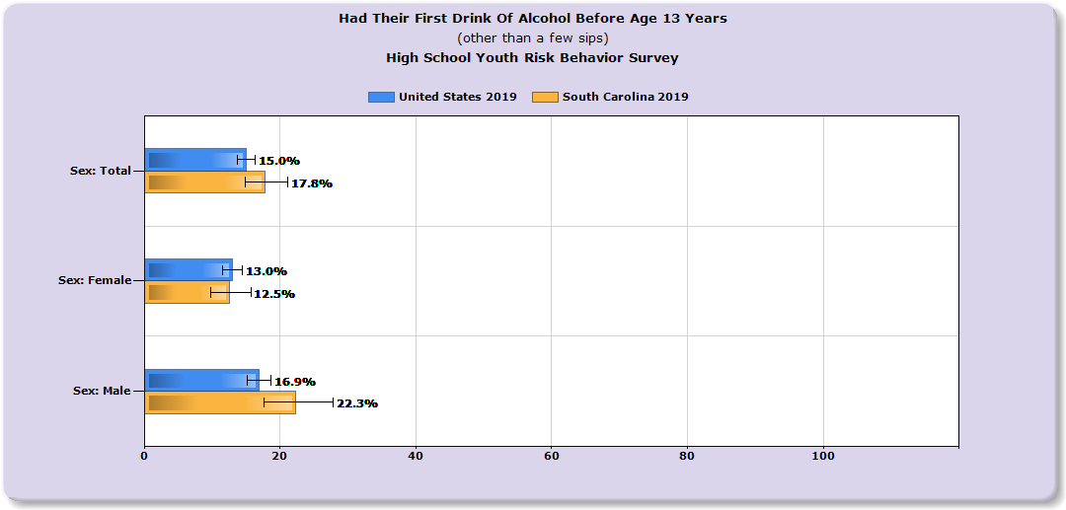
South Carolina Data- Alcohol
Source: https://nccd.cdc.gov/youthonline/App/Results

Slide 66
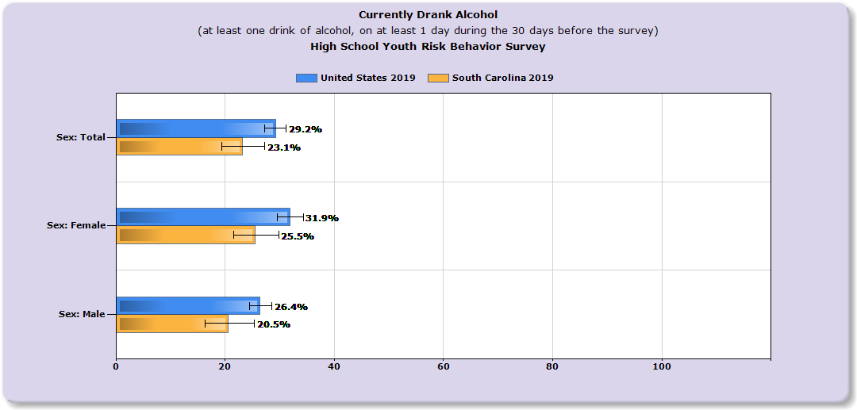
South Carolina Data- Alcohol
Source: https://nccd.cdc.gov/youthonline/App/Results

Slide 67
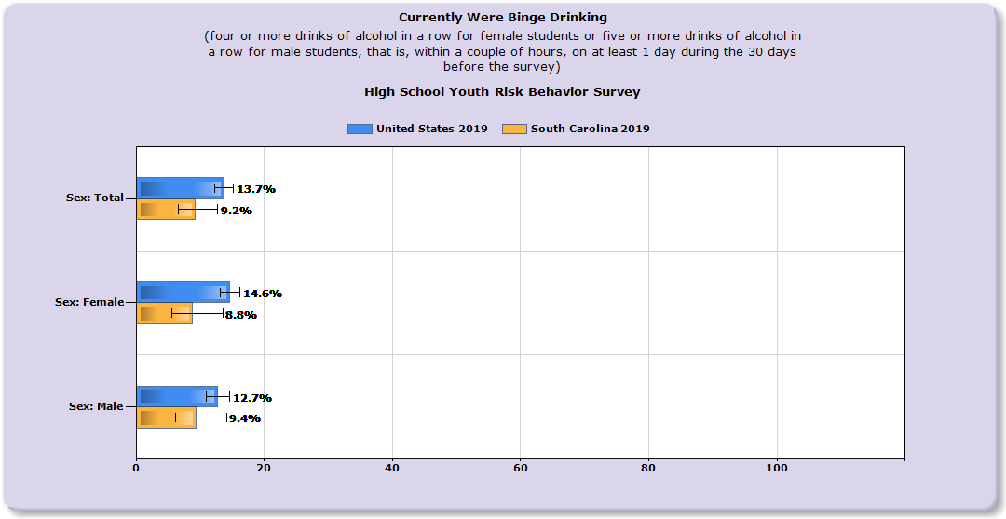
South Carolina Data- Alcohol
Source: https://nccd.cdc.gov/youthonline/App/Results

Slide 68
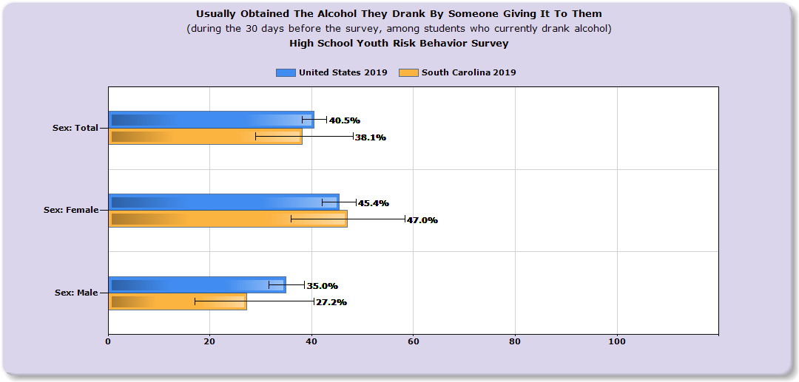
South Carolina Data- Alcohol
Source: https://nccd.cdc.gov/youthonline/App/Results

Slide 69
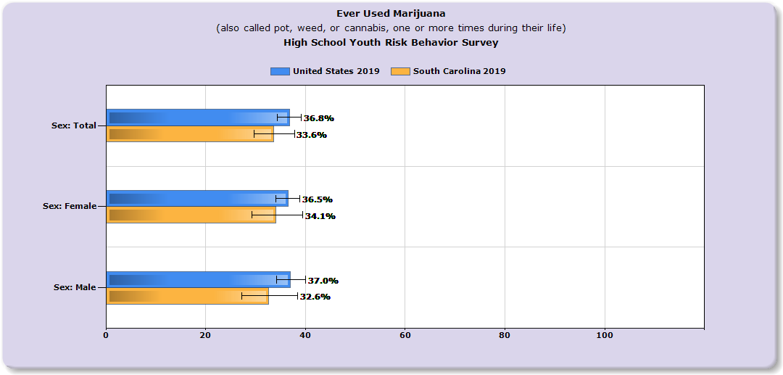
South Carolina Data- Marijuana
Source: https://nccd.cdc.gov/youthonline/App/Results

Slide 70
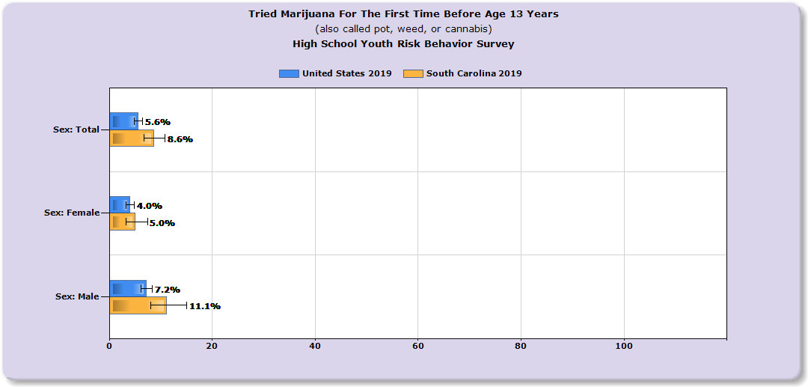
South Carolina Data- Marijuana
Source: https://nccd.cdc.gov/youthonline/App/Results

Slide 71
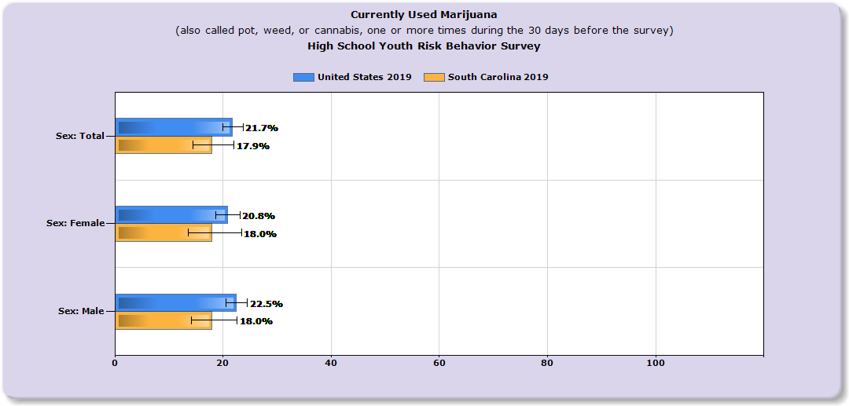
South Carolina Data-Marijuana
Source: https://nccd.cdc.gov/youthonline/App/Results

Slide 72
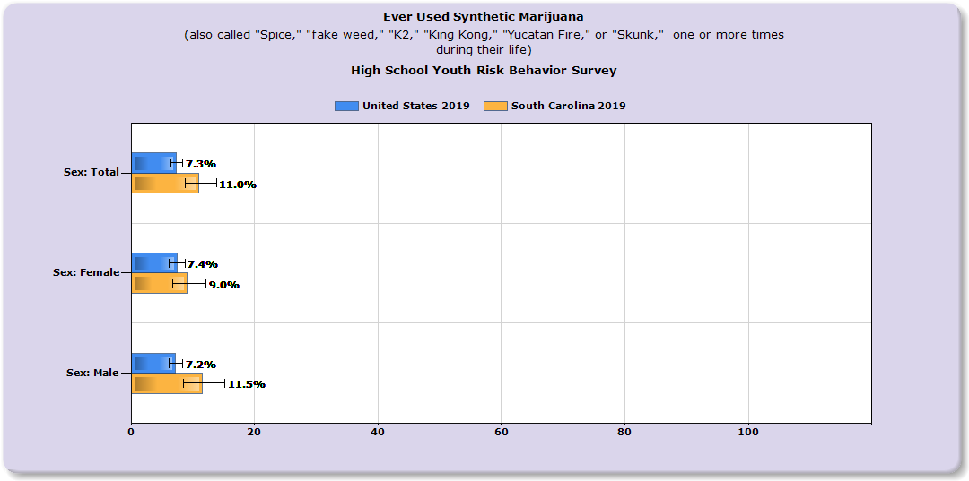
South Carolina Data-Marijuana
Source: https://nccd.cdc.gov/youthonline/App/Results

Slide 73
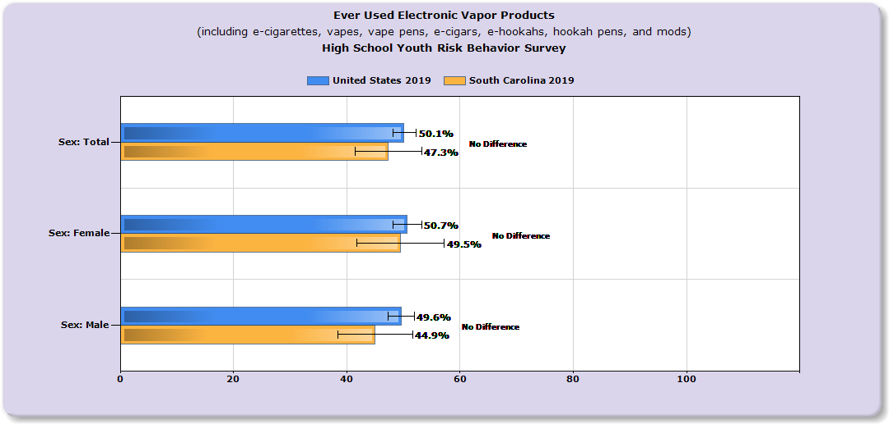
South Carolina Data-Vapes
Source: https://nccd.cdc.gov/youthonline/App/Results

Slide 74
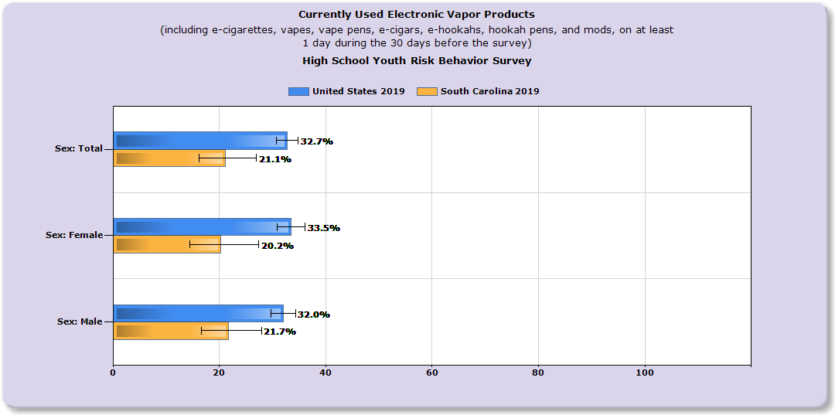
South Carolina Data-Vapes
Source: https://nccd.cdc.gov/youthonline/App/Results

Slide 75
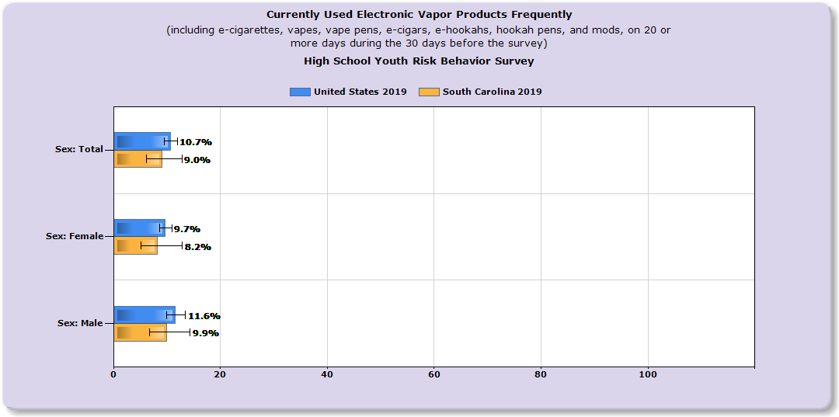
South Carolina Data-Vapes
Source: https://nccd.cdc.gov/youthonline/App/Results

Slide 76
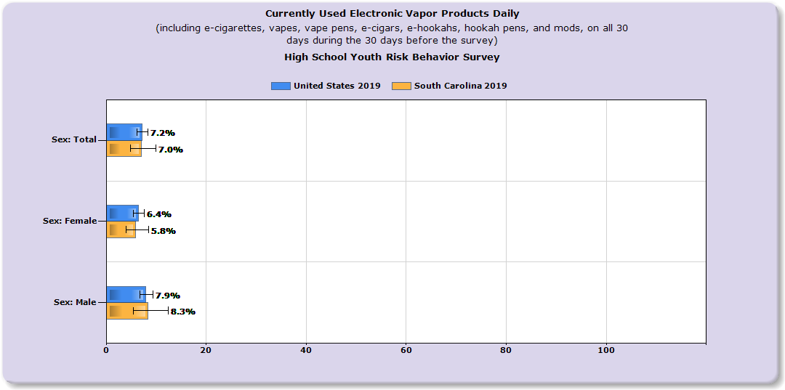
South Carolina Data-Vapes
Source: https://nccd.cdc.gov/youthonline/App/Results

Slide 77
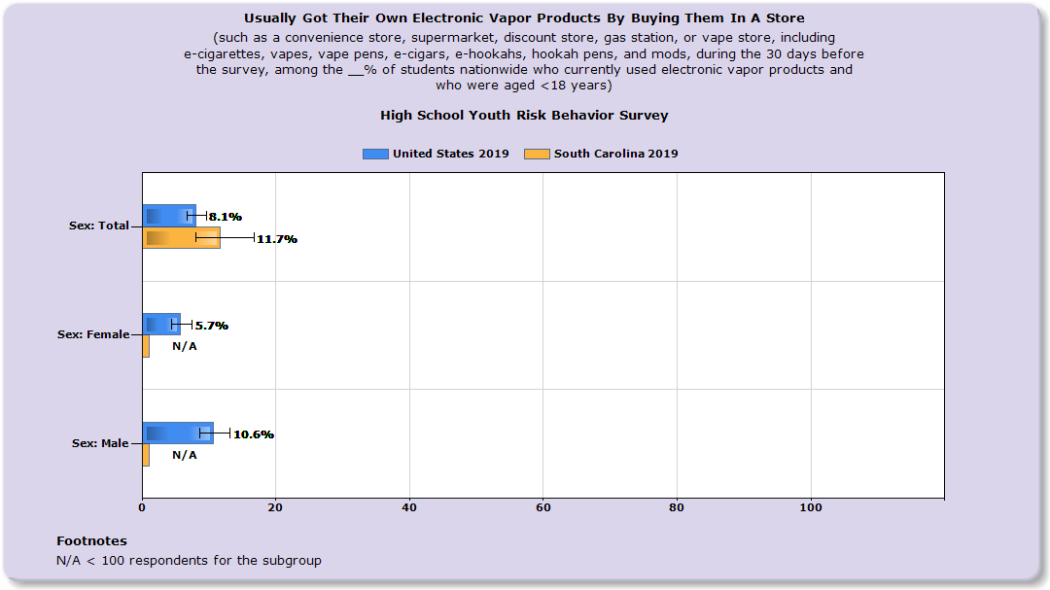
South Carolina Data-Vapes
Source: https://nccd.cdc.gov/youthonline/App/Results

Slide 78
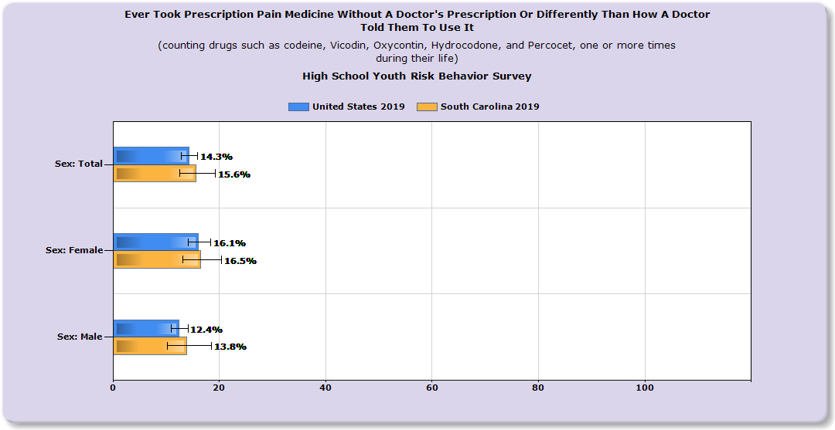
South Carolina Data-Prescription Drugs
Source: https://nccd.cdc.gov/youthonline/App/Results

Slide 79
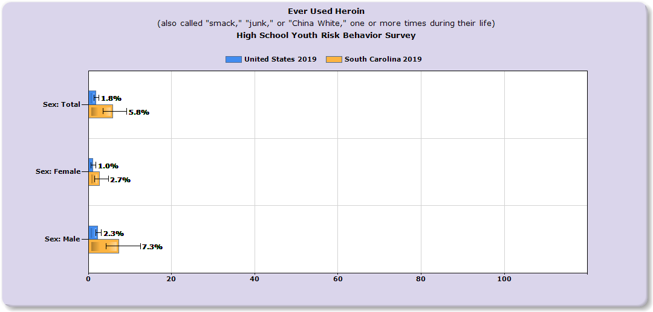
South Carolina Data-Heroin
Source: https://nccd.cdc.gov/youthonline/App/Results

Slide 80
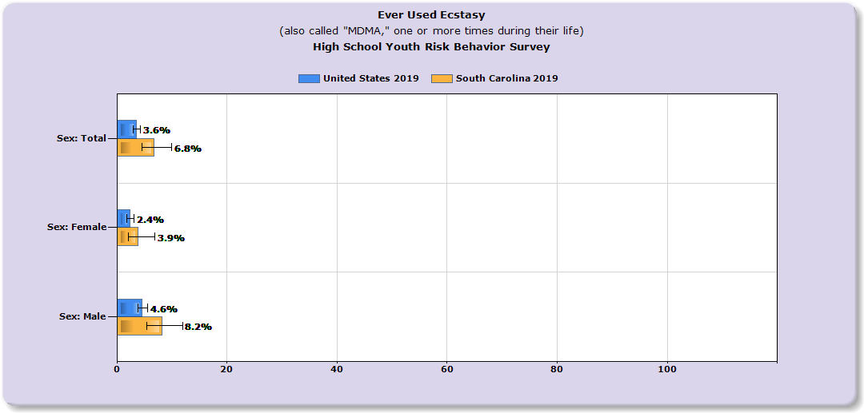
South Carolina Data-Ecstasy
Source: https://nccd.cdc.gov/youthonline/App/Results

Slide 81
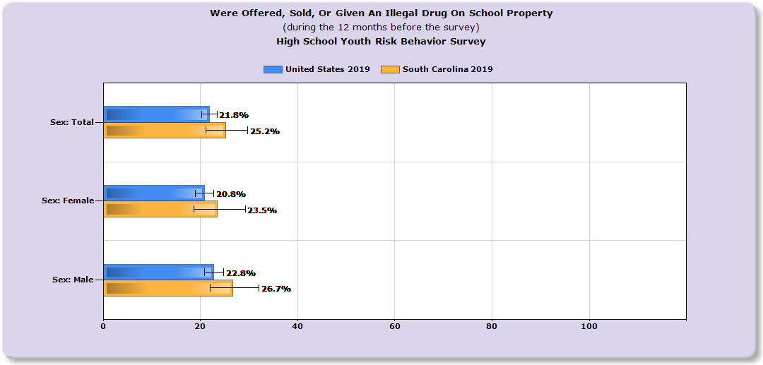
South Carolina Data-Drugs on School Property
Source: https://nccd.cdc.gov/youthonline/App/Results

Slide 82
IN CLOSING
Talk to your kids! Have several drug "conversations."
Education and prevention start early.
Drug abuse prevention requires a multifaceted approach.
Seek help from a professional early if needed!

Slide 83
Ways to Talk to Teens
Talk with teens in your life about pain treatment and management. Regardless of drug use history, reach out to youth:
Building strong relationships with adolescents is the first step to connecting with youth on drug prevention.
Collaboration between and within youth-serving sectors and community partnerships presents opportunities to reach at-risk and drug-naïve adolescents by increasing the efficiency of care, communicating across providers, and breaking down stigmas.
Combining services such as trauma-informed care and psychological support with mentors and peers in the same location can also be an effective way to reach and help youth.
Source: hhs.gov

Slide 84
Resources for Parents & Professionals
CDC Quick Vape Facts - https://www.cdc.gov/tobacco/basic_information/e-cigarettes/Quick-Facts-on-the-Risks-of-E-cigarettes-for-Kids-Teens-and-Young-Adults.html
CDC Teen Vape Sheets - https://www.cdc.gov/tobacco/basic_information/e-cigarettes/Quick-Facts-on-the-Risks-of-E-cigarettes-for-Kids-Teens-and-Young-Adults.html
CDC Ecig/Product - Dictionary-images-https://www.cdc.gov/tobacco/basic_information/e-cigarettes/pdfs/ecigarette-or-vaping-products-visual-dictionary-508.pdf
Surgeon General - Vapes-https://e-cigarettes.surgeongeneral.gov/knowtherisks.html
CDC Smoking & Youth - https://www.cdc.gov/tobacco/data_statistics/sgr/50th-anniversary/pdfs/fs_smoking_youth_508.pdf
CDC What Are E Cigs? - https://www.cdc.gov/tobacco/basic_information/e-cigarettes/about-e-cigarettes.html
Vape Facts by Johns Hopkins Medicine - https://www.hopkinsmedicine.org/health/wellness-and-prevention/5-truths-you-need-to-know-about-vaping
TALL COP SAYS STOP Website: www.tallcopsaysstop.com

Slide 85
YOUR CONTACT INFO HERE
Contact Info

